Slide 1
Dogma vs Consensus: Letting the Evidence Speak on Climate Change
John Cook
Global Change Institute, University of Queensland
^{19 Sep 2013}

Slide 3
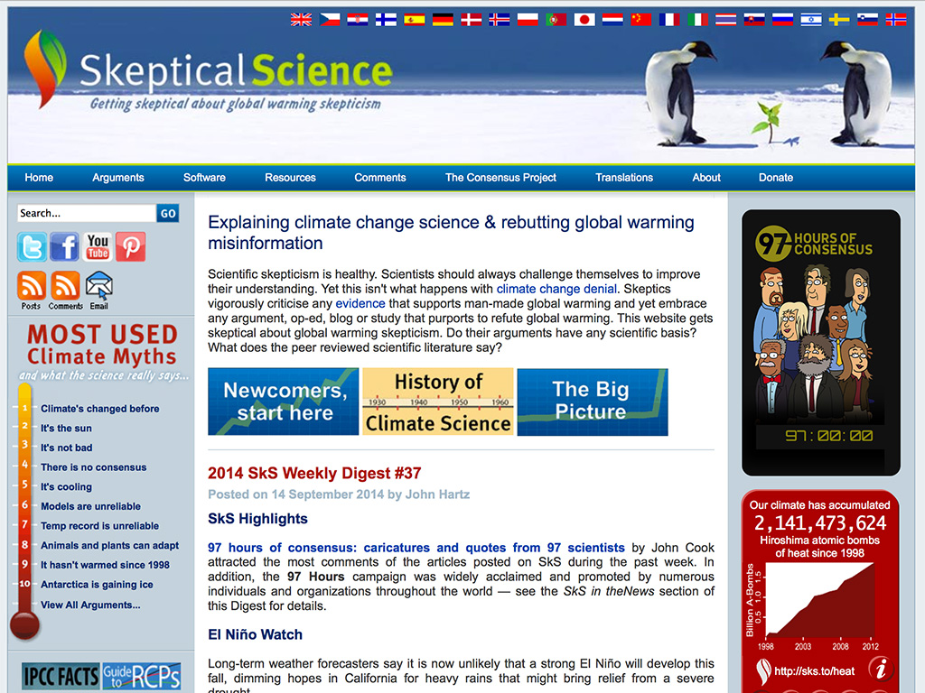

Slide 5
Dogma vs Consensus
Our scientific understanding of global warming
How people think about climate change
Scientific consensus

Slide 6
“Science is not a democracy. It is a dictatorship. It is evidence that does the dictating.”
JOHN REISMAN

Slide 7
Understanding global warming
270 Americans asked to explain the mechanism causing global warming (Ranney et al., 2012)
Zero participants succeeded in explaining the mechanism
In 2013, I asked the same question to a class of 2nd year UQ Environmental Engineering students
Zero students succeeded in explaining the mechanism
Yesterday, I asked at the University of York
One person succeeded
… with an American accent!

Slide 8
Question to the room:
Explain the mechanism causing global warming

Slide 9
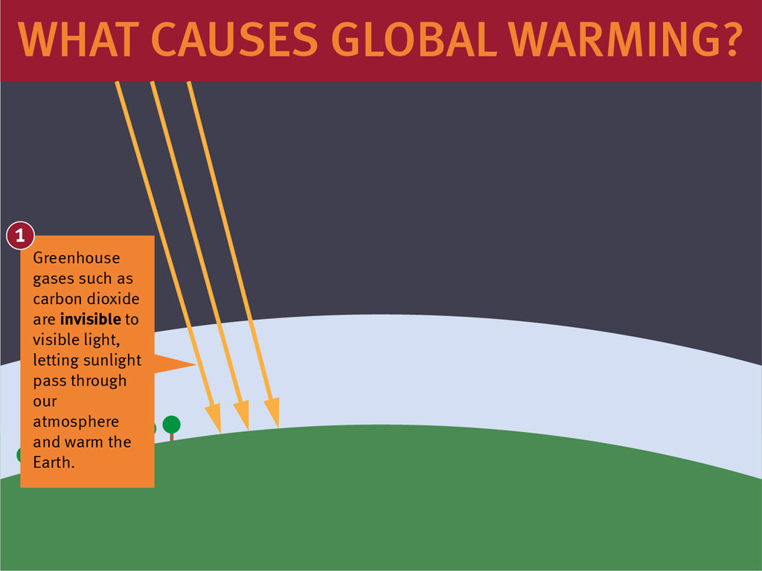

Slide 10
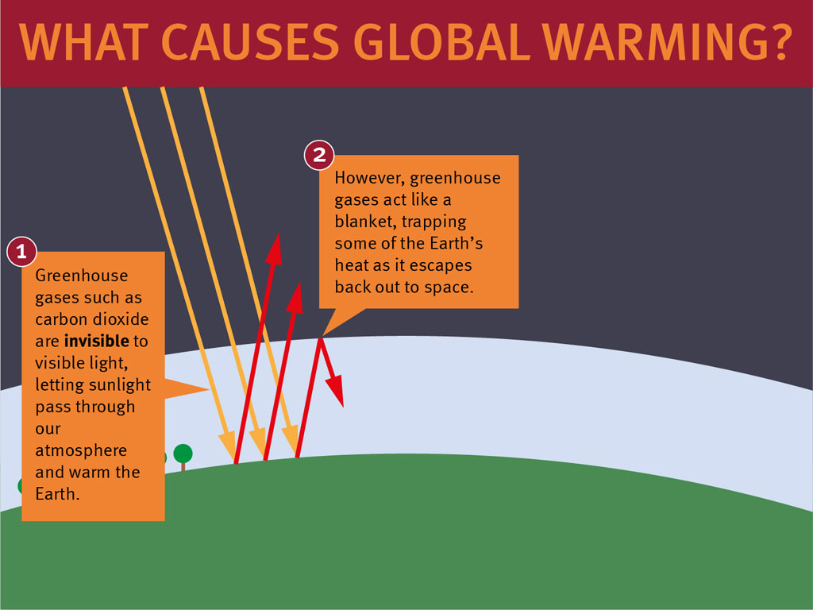

Slide 11
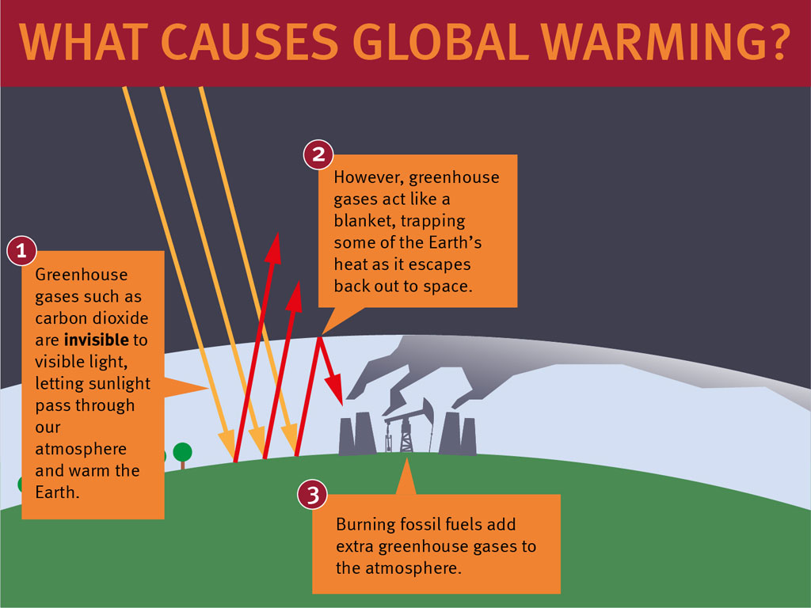

Slide 12
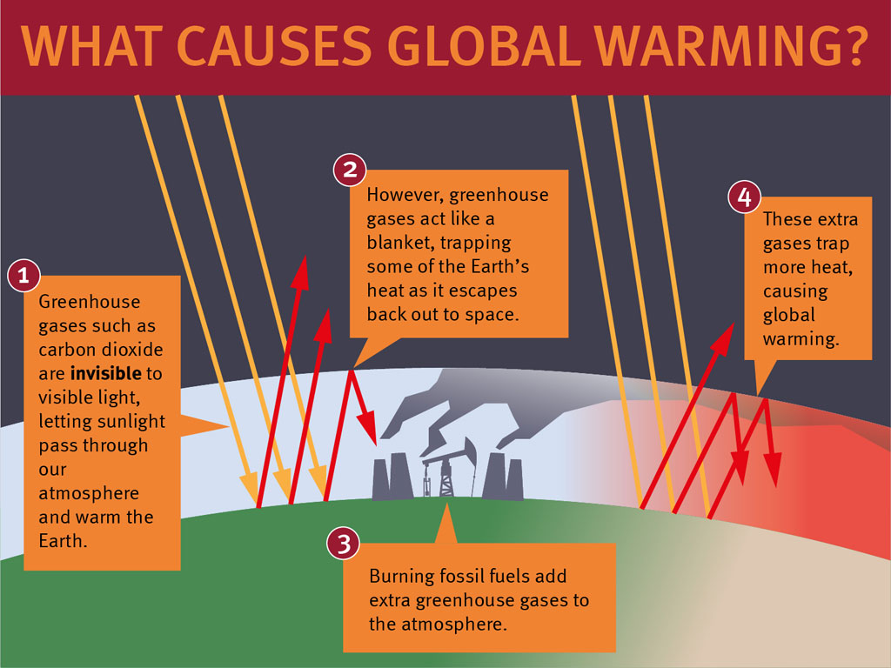

Slide 15
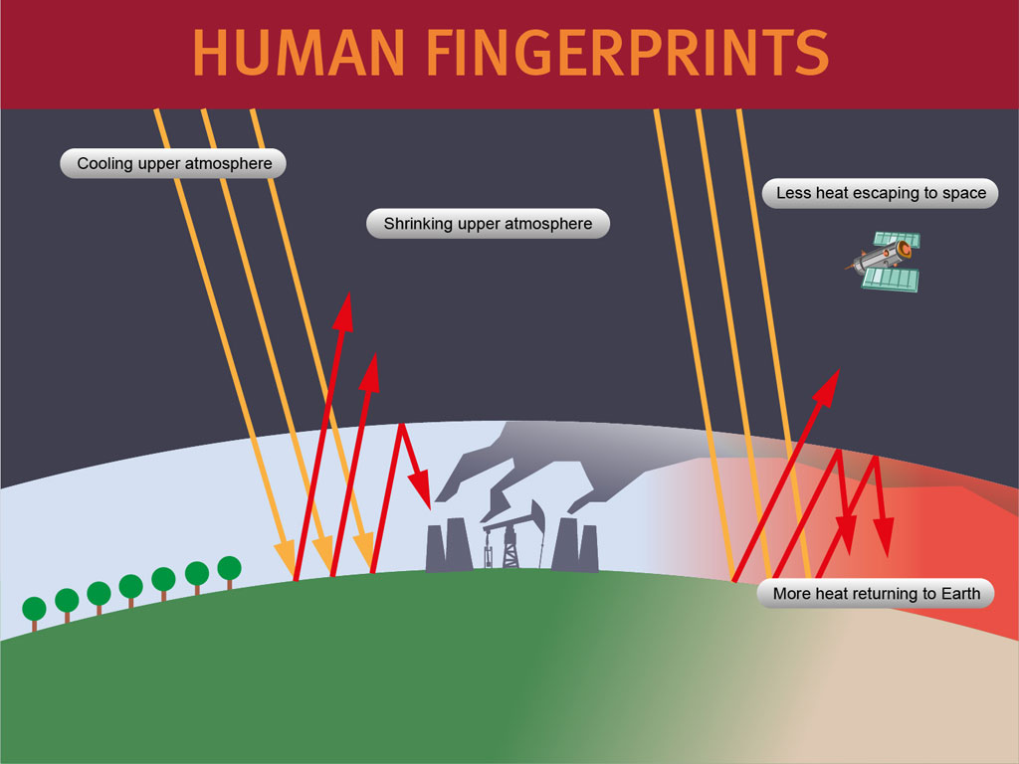

Slide 17
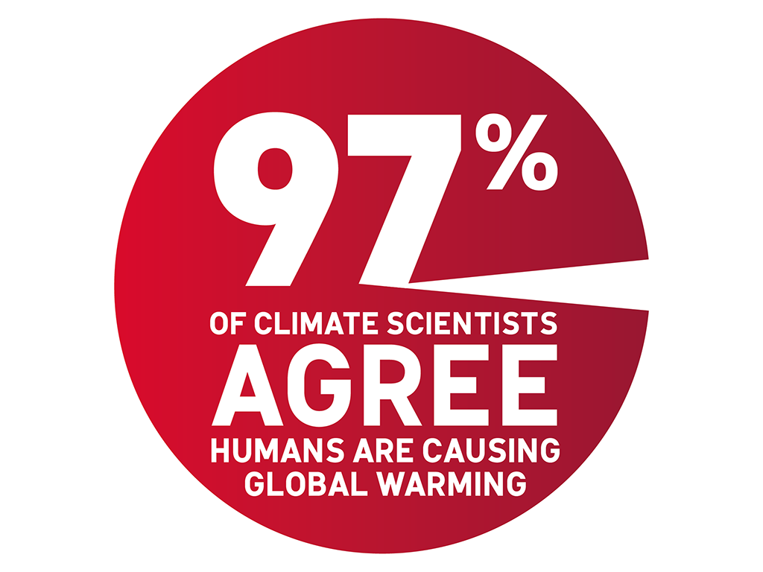

Slide 18
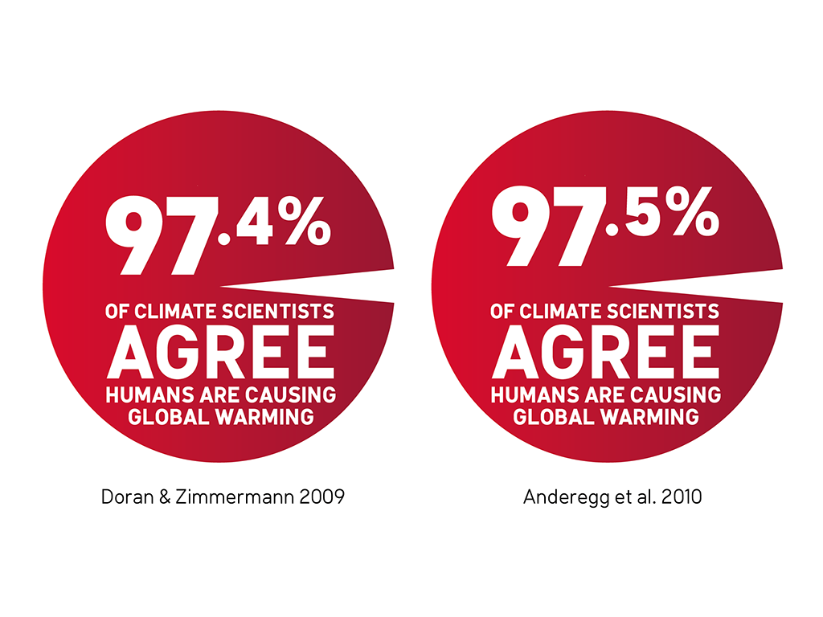

Slide 20
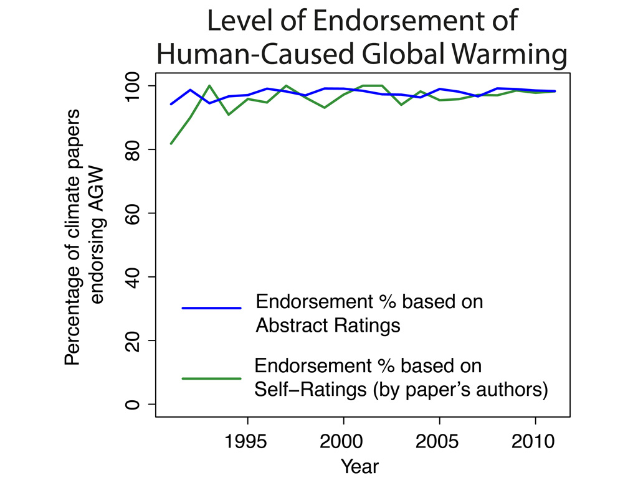
Cook et al 2013

Slide 21
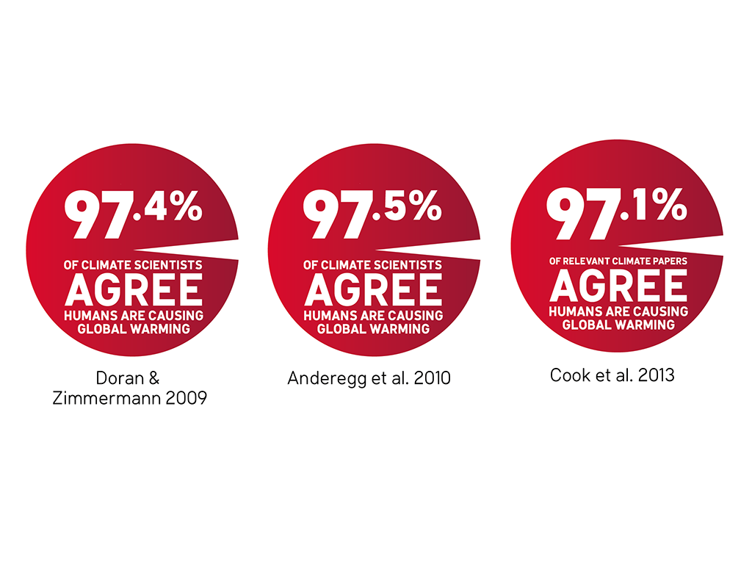

Slide 22
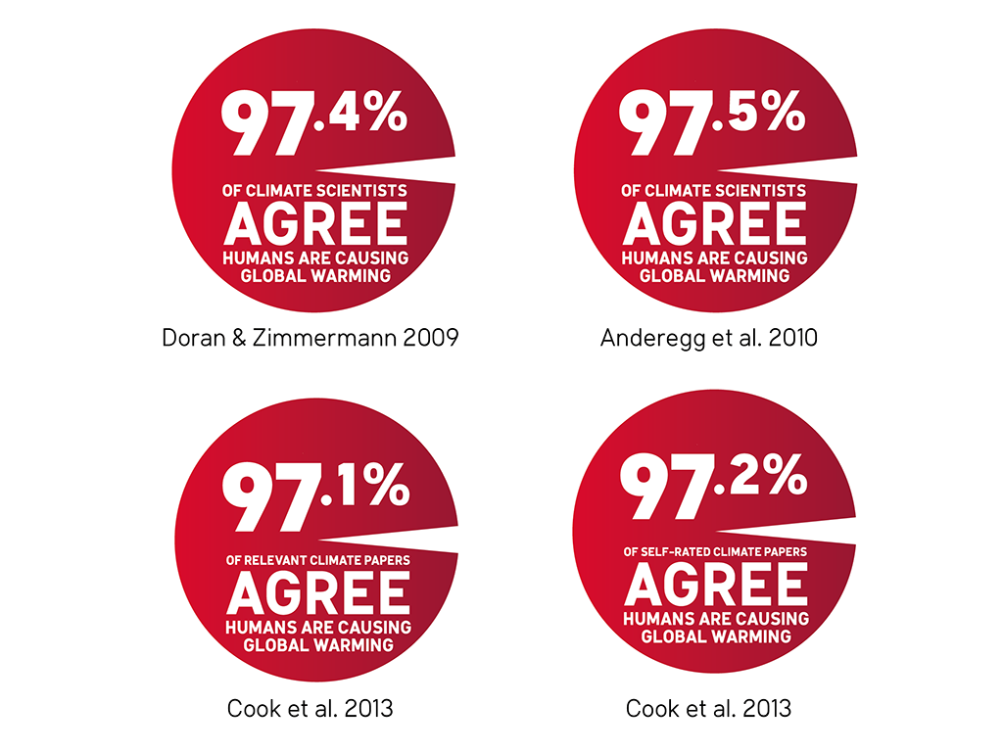

Slide 23
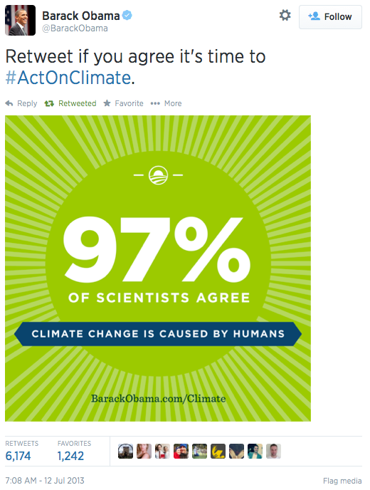
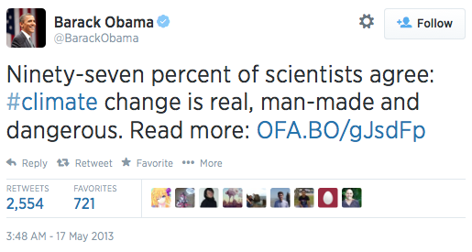

Slide 24
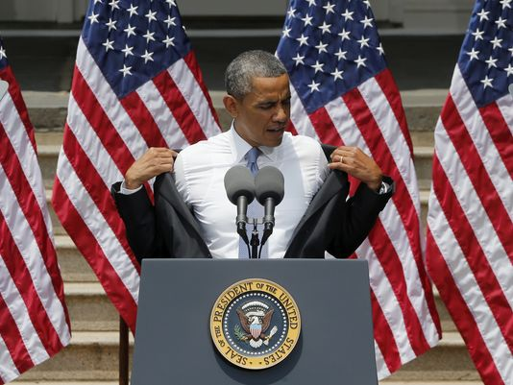

Slide 25
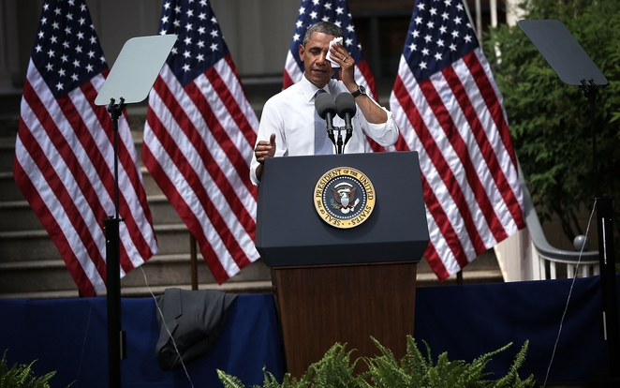

Slide 26
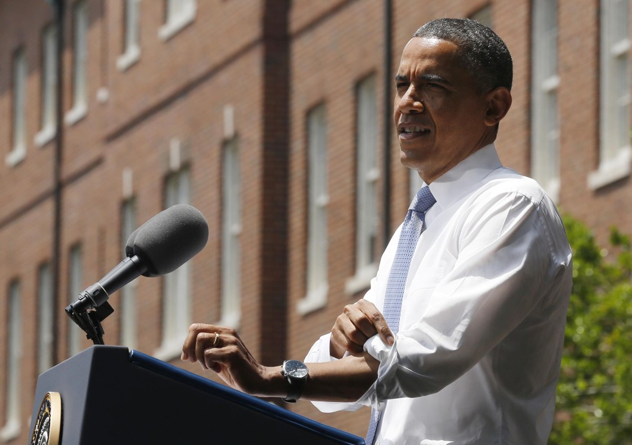
“97% of scientists, including, by the way, some who originally disputed the data, have now put that to rest. They’ve acknowledged the planet is warming and human activity is contributing to it.”
PRESIDENT OBAMA

Slide 27
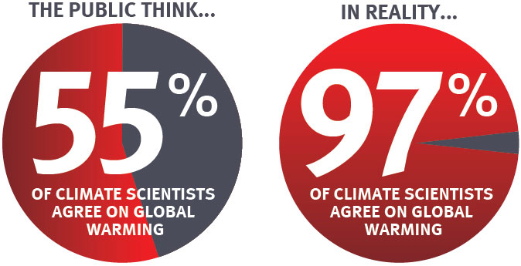
The “Consensus Gap”

Slide 28
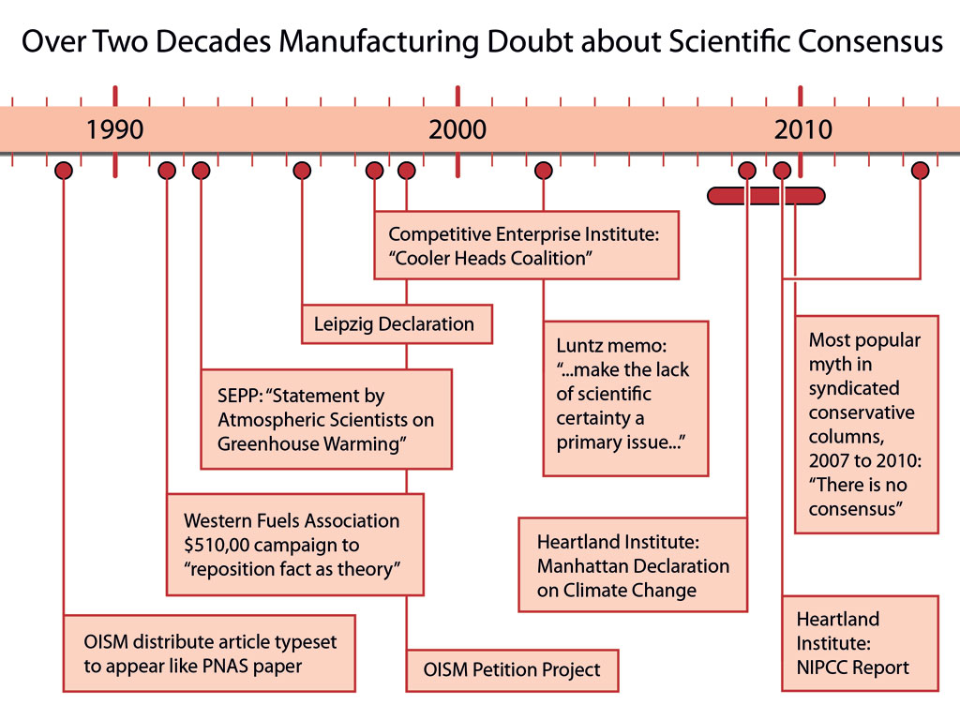
“Should the public come to believe that the scientific issues are settled, their views about global warming will change accordingly. Therefore, you need to continue to make the lack of scientific certainty a primary issue in the debate.”
FRANK LUNTZ

Slide 29
Why consensus is important
For complicated scientific topics, the public rely on expert opinion as a mental shortcut (heuristic) to form their views on the science.
Communicating consensus isn’t about proving climate change. It’s addresses a public misconception about expert opinion.

Slide 30
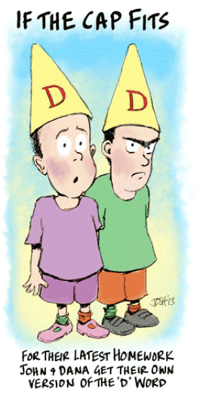
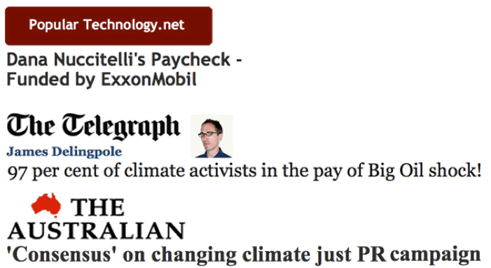

Slide 31
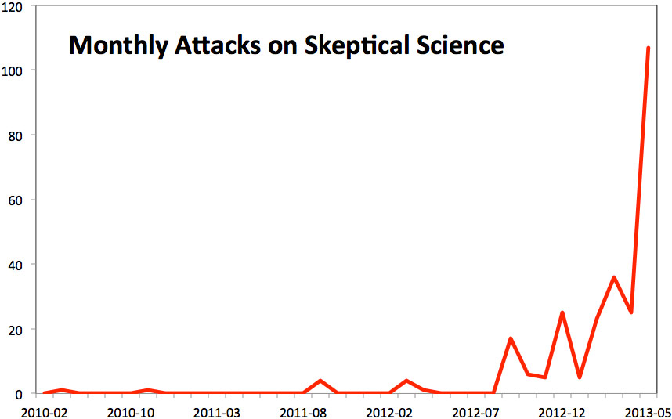

Slide 32
5 Techniques of Climate Science Denial

Slide 33
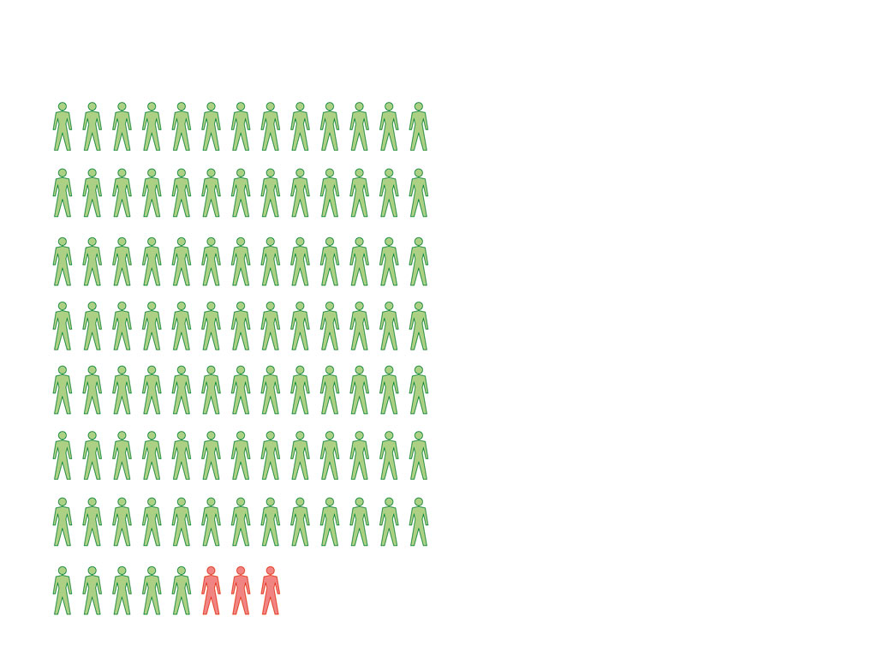
97% Consensus
Consensus

Slide 34
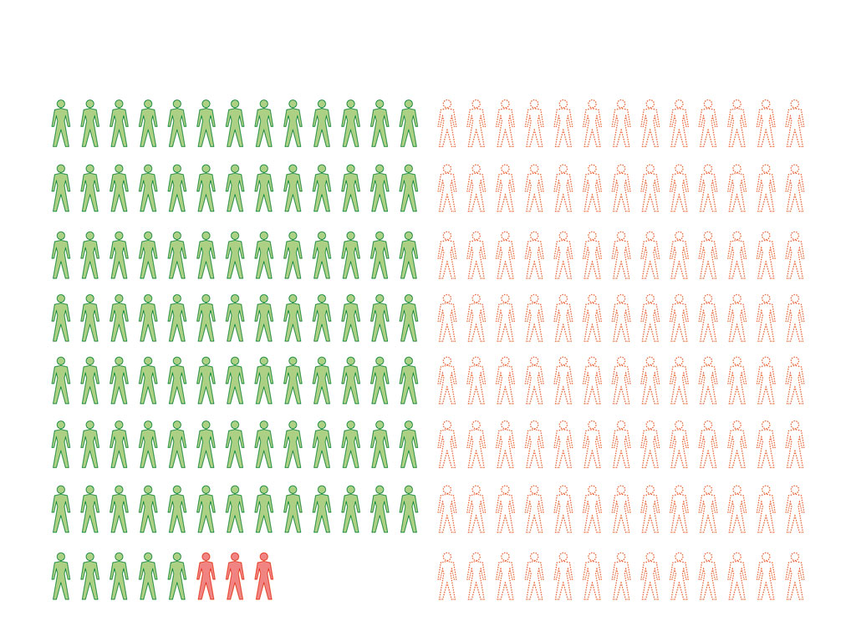
Consensus
Fake Experts
Fake Experts

Slide 35
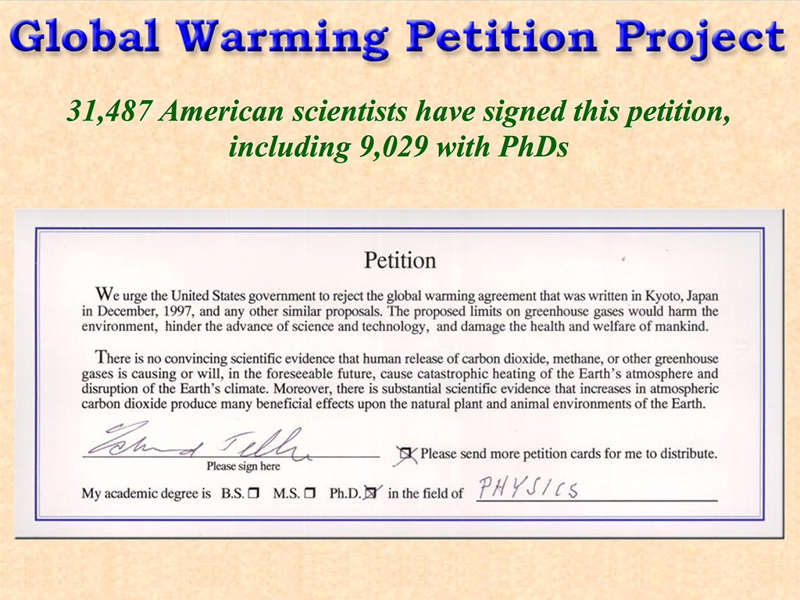

Slide 36
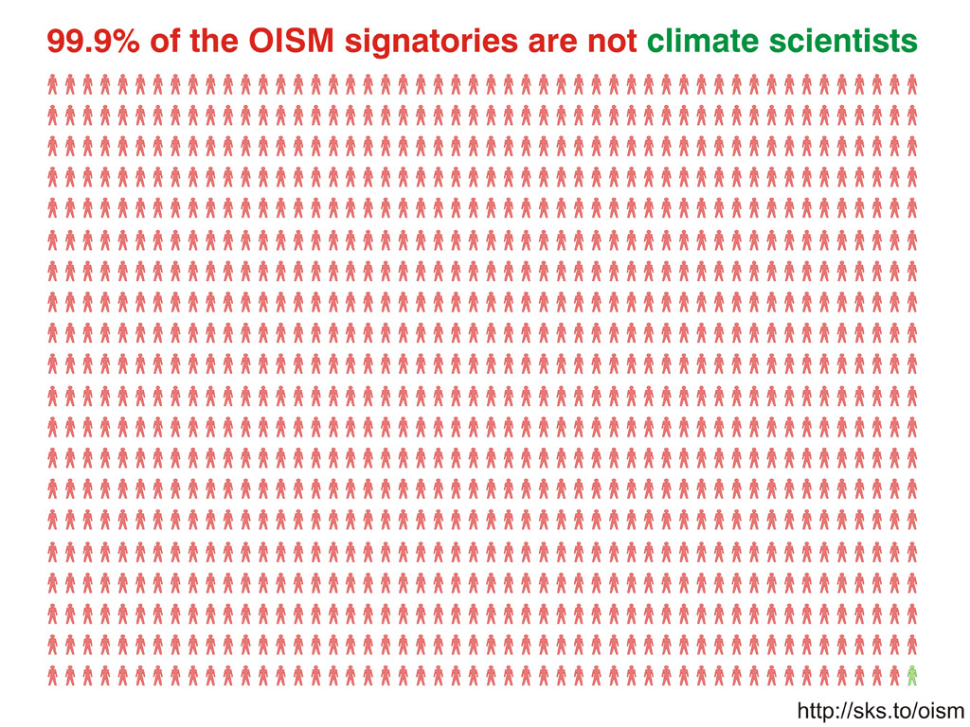

Slide 38
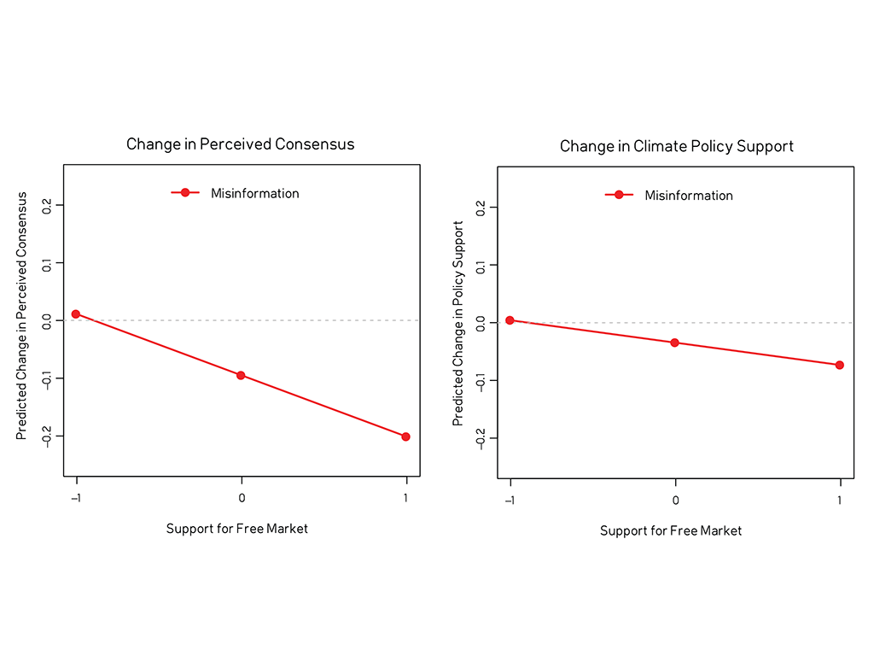

Slide 39
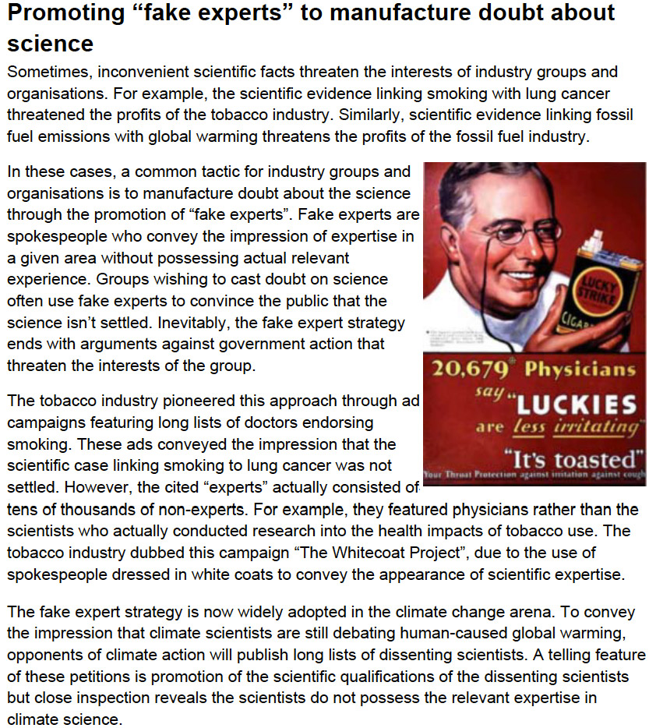

Slide 40
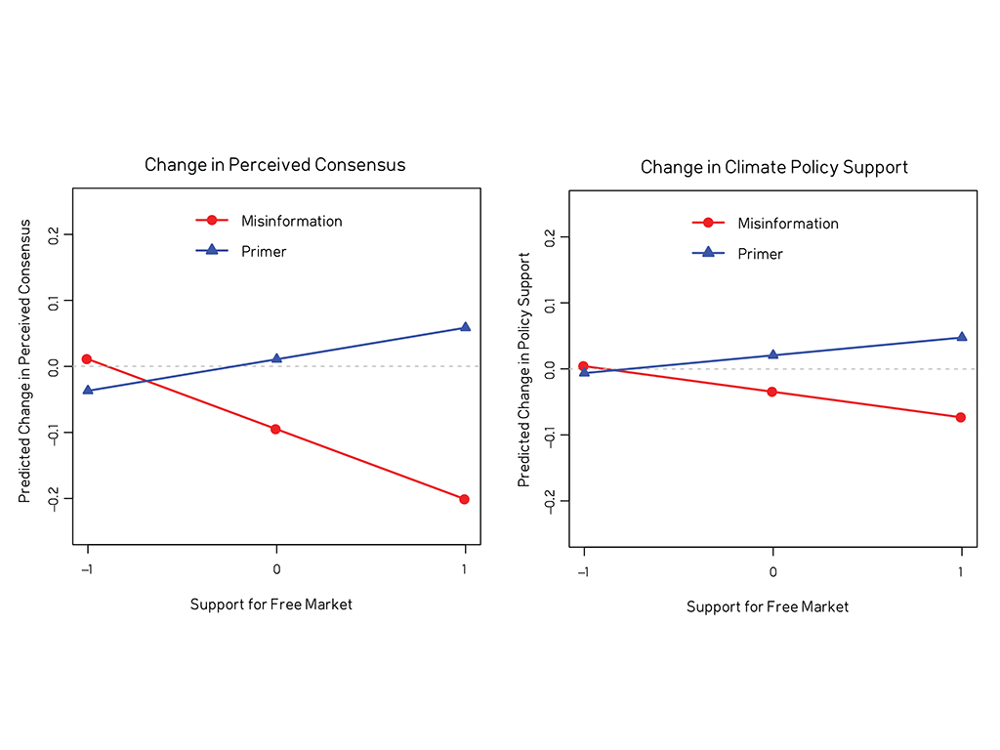

Slide 41
Neutralising misinformation
Explaining the techniques of science denial neutralises the influence of misinformation.
It can even cause misinformation to backfire.
Other strands of research find same result:
Inoculation Theory
Agnotology-Based Learning.

Slide 42
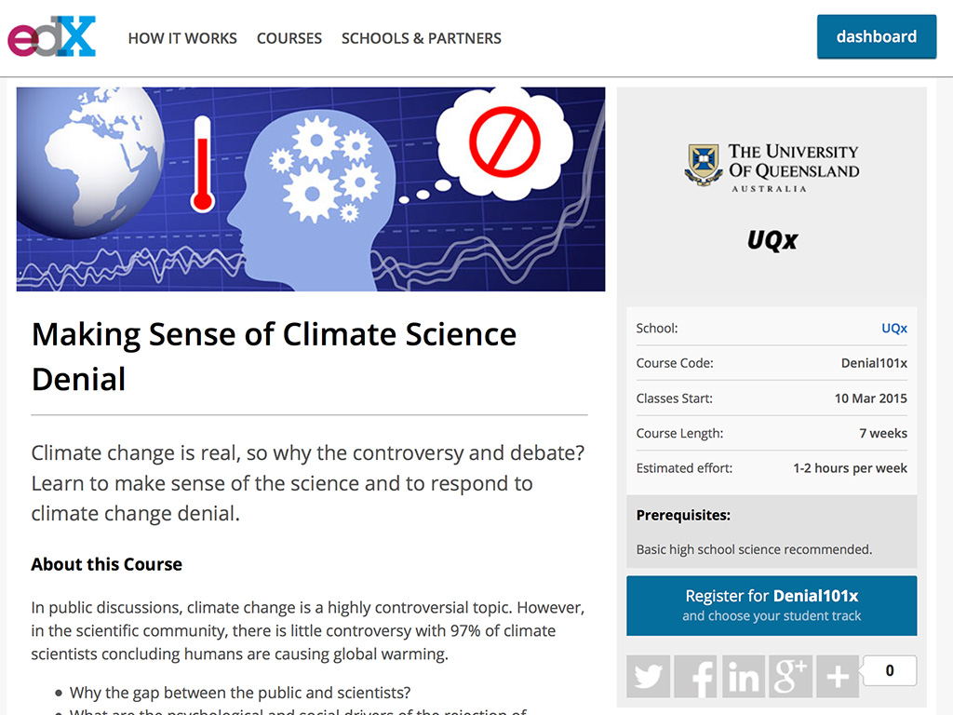
http://sks.to/denial101x

Slide 43
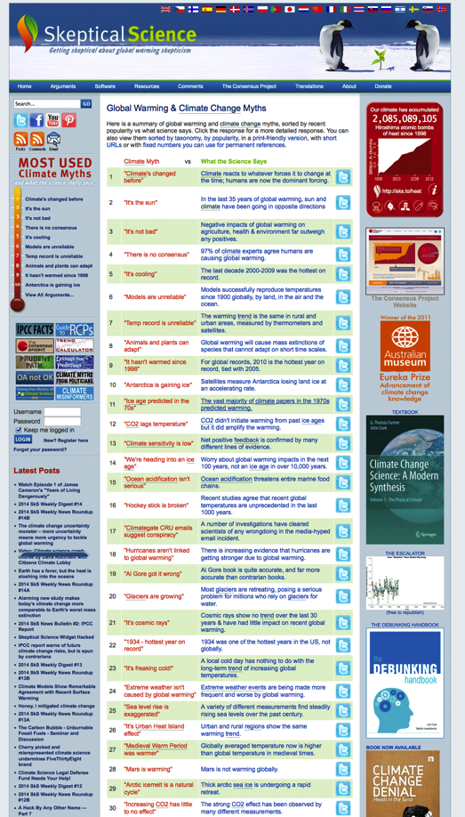
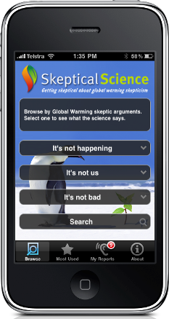
Questions?
http://skepticalscience.com
http://sks.to/iphone

