Slide 1



Closing the consensus gap a key
to increasing support for climate action
John Cook
Global Change Institute, University of Queensland
^{19 Sep 2013}

Slide 2


“Science is not a democracy.
It is a dictatorship.
It is evidence that does the dictating.”
JOHN REISMAN

Slide 3
Understanding global warming
Mike Ranney asked 270 Americans to explain the mechanism causing global warming (Ranney et al., 2012)
Zero participants succeeded in explaining the mechanism
I asked the same question to a class of 2nd year UQ Environmental Engineering students
Zero students succeeded in explaining the mechanism

Slide 4
Question to the room:
Explain the mechanism
causing global warming

Slide 5
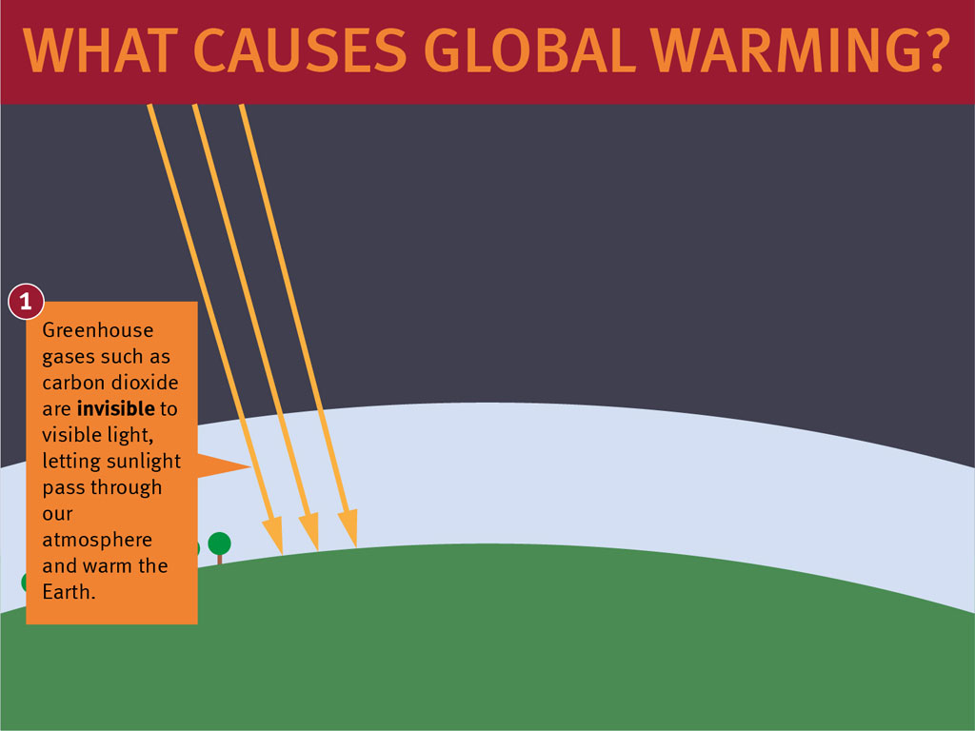

Slide 6
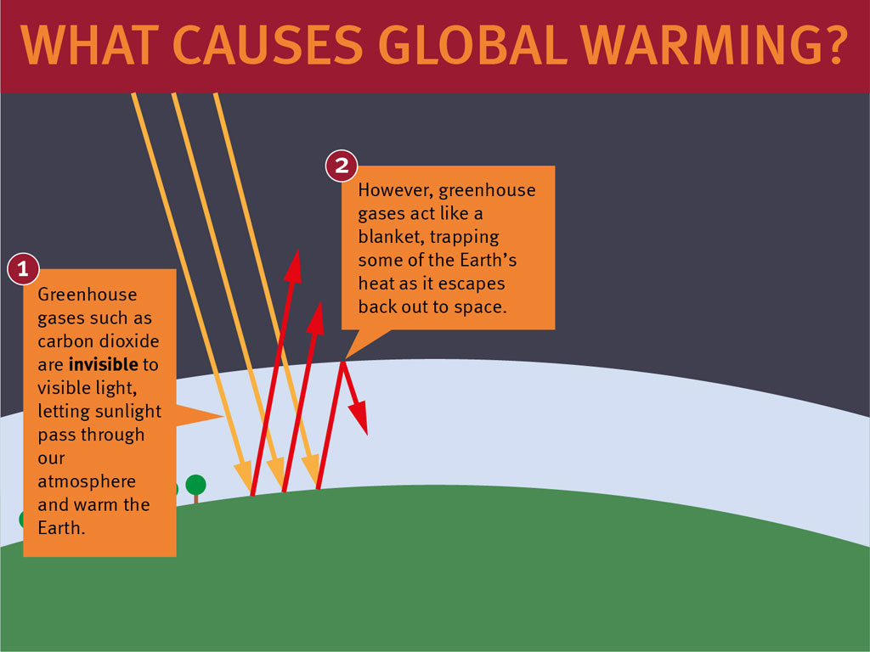

Slide 7
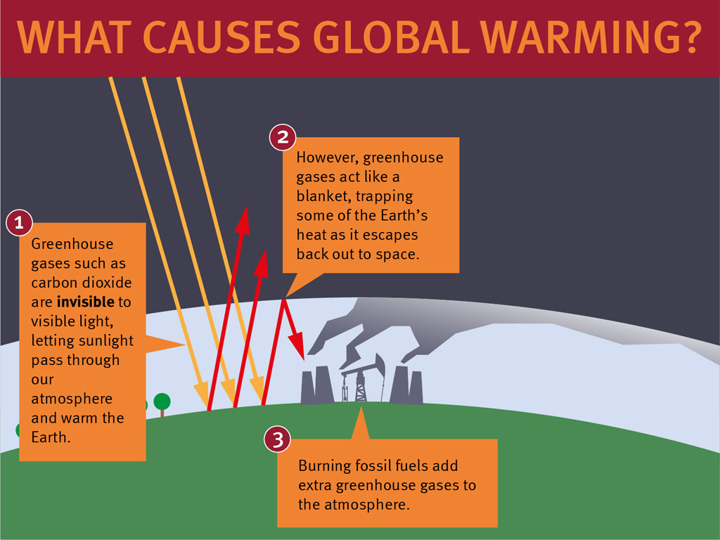

Slide 8
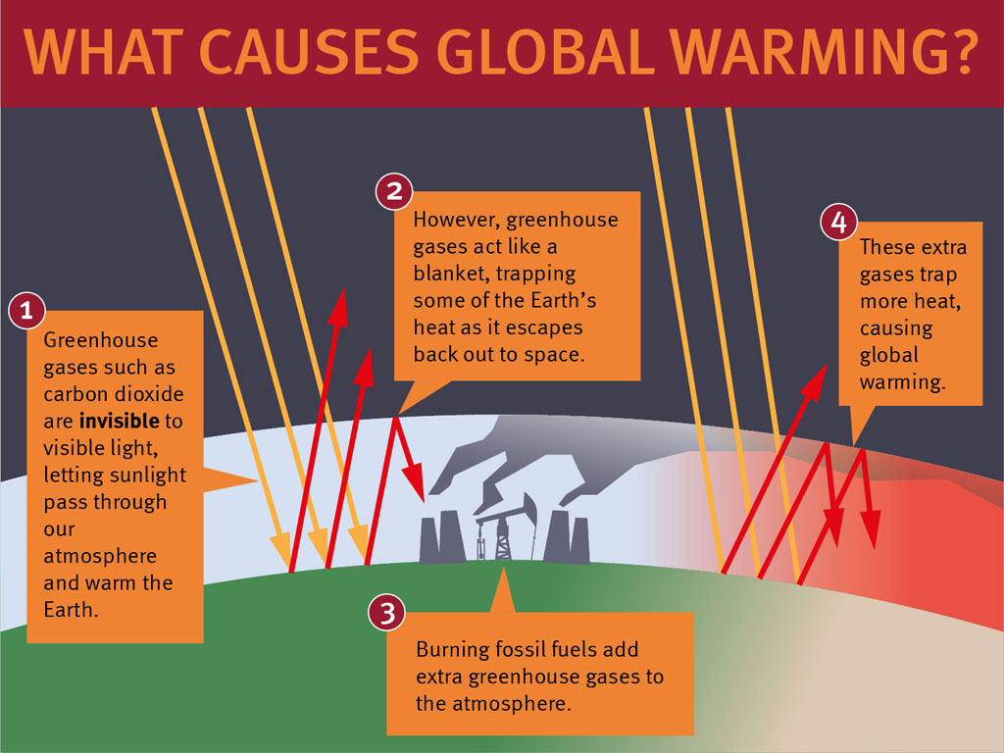

Slide 9
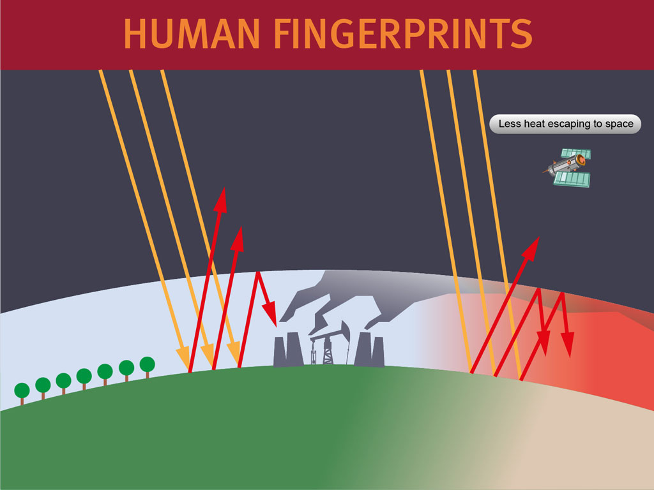

Slide 10


Slide 11
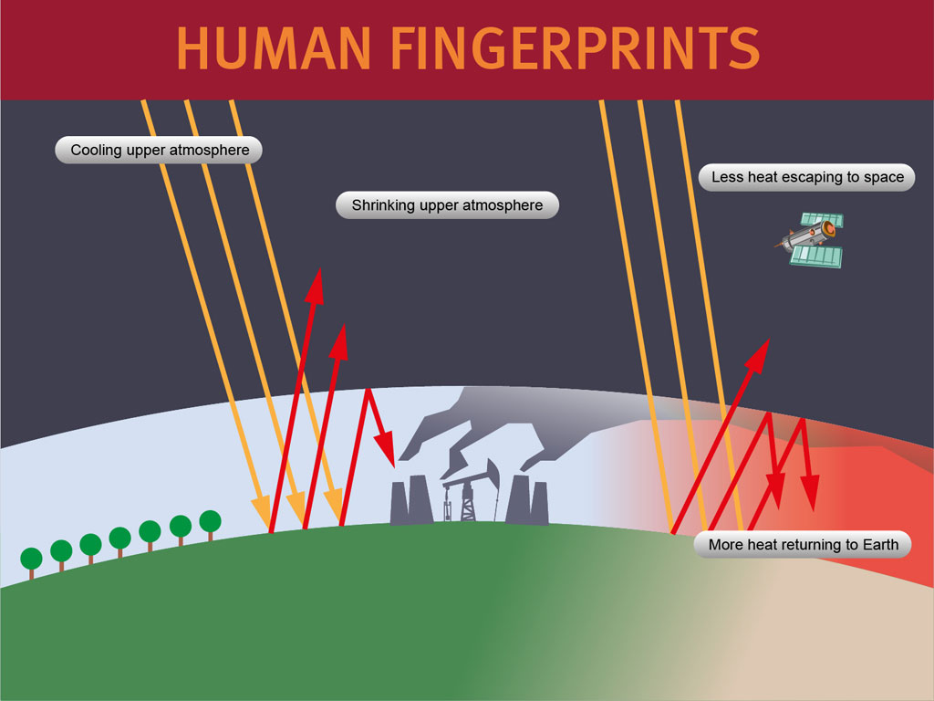

Slide 12
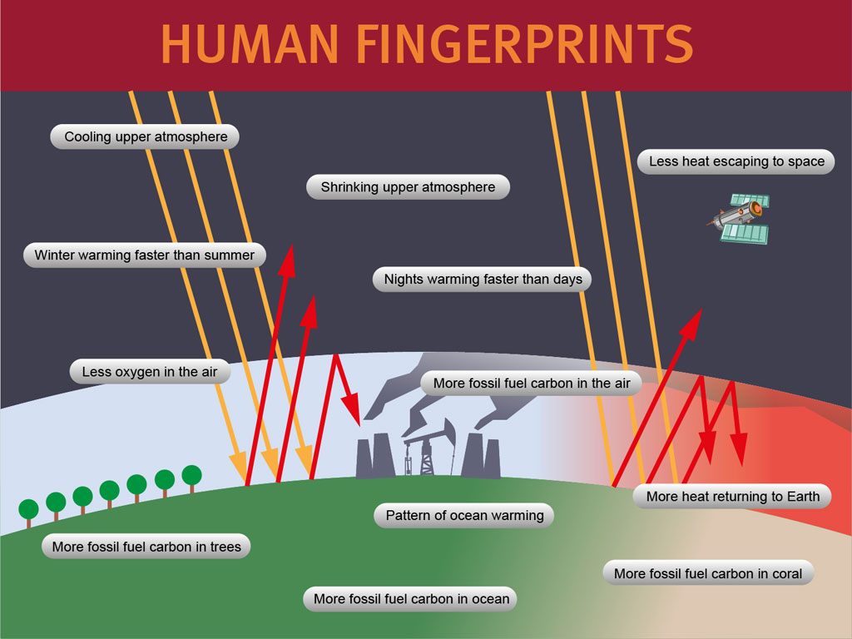

Slide 13
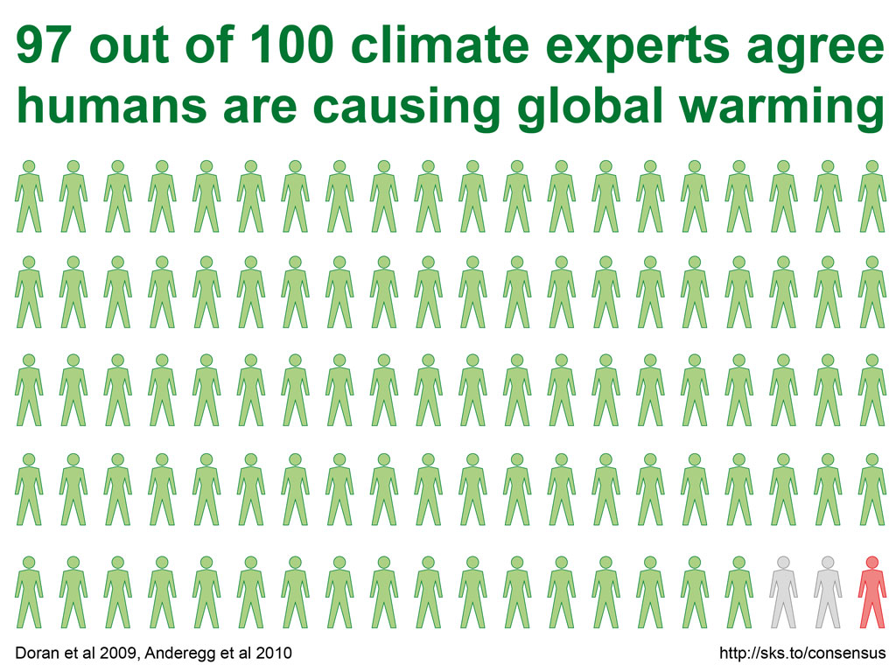

Slide 14
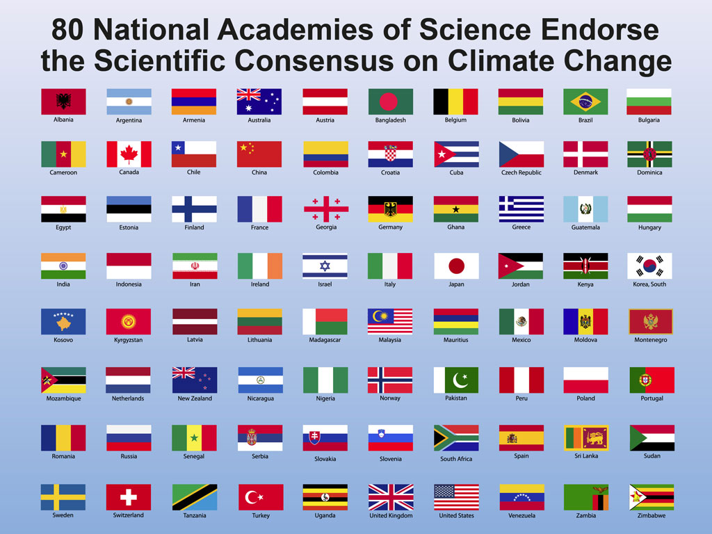
DISSENTING ORGANISATION:
American Association of
Petroleum Geologists

Slide 15
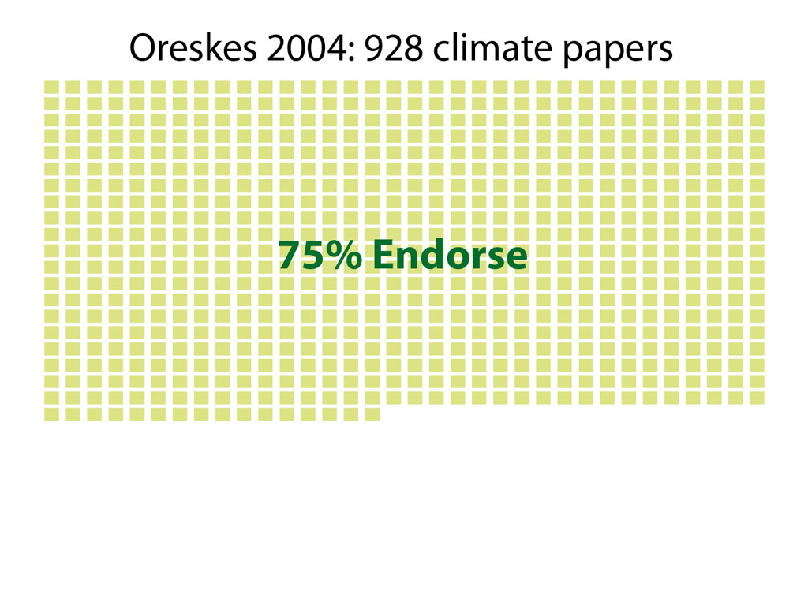

Slide 16
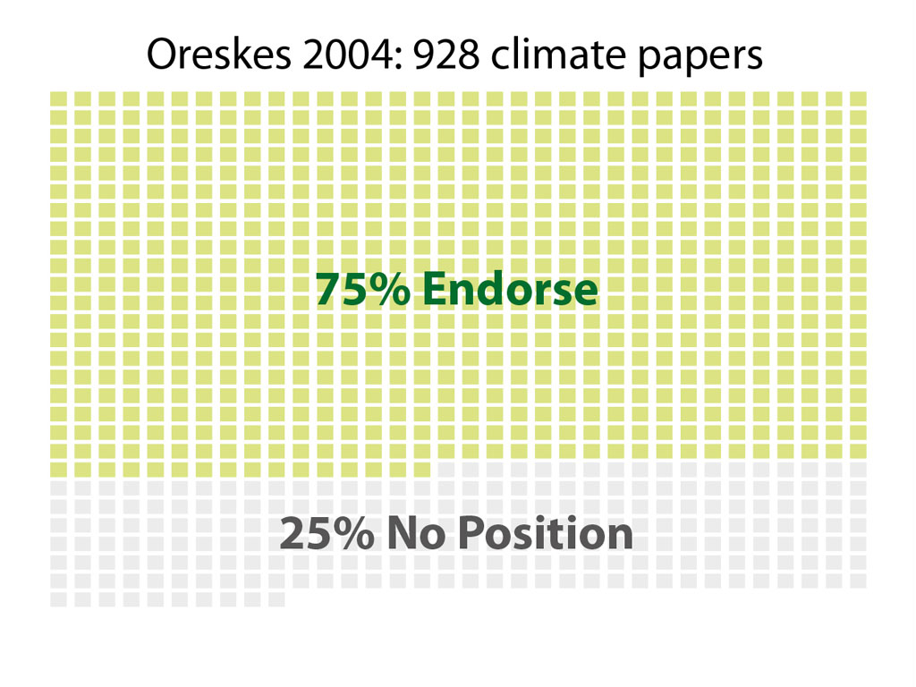

Slide 17
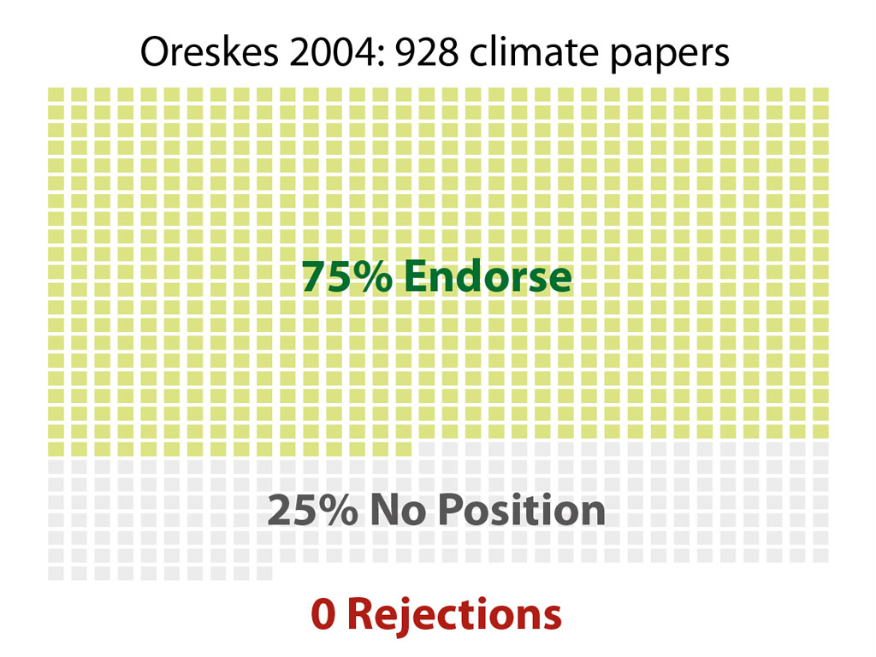

Slide 18
The Scientific Consensus is Robust
Consensus of evidence
Consensus in the climate science community
Consensus among scientific organisations
Consensus in the peer-reviewed literature

Slide 19
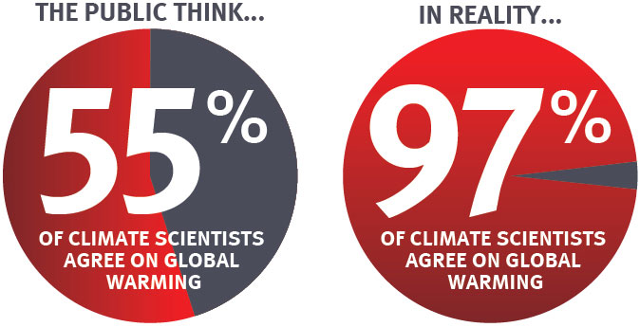
The “Consensus Gap”

Slide 20
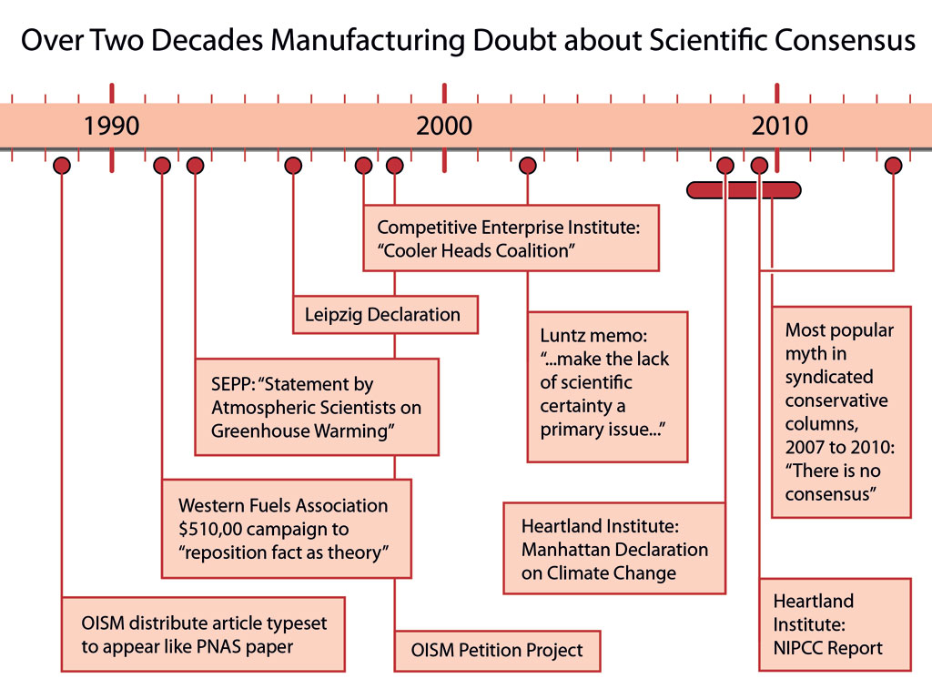
“Voters believe that there is no consensus about global warming in the scientific community. Should the public come to believe that the scientific issues are settled, their views about global warming will change accordingly. Therefore, you need to continue to make the lack of scientific certainty a primary issue in the debate.”
FRANK LUNTZ

Slide 21
The importance of consensus
Ding et al 2011 found that people who believe scientists disagree on global warming are less likely to support climate policy
McCright et al 2013:
“Climate change communicators should therefore identify opportunities and employ techniques to effectively counter the denial machine’s campaign of challenging the scientific consensus. Overcoming its success in generating belief that scientists do not agree about anthropogenic global warming seems to be crucial for increasing public support for emissions reduction policies.”

Slide 22
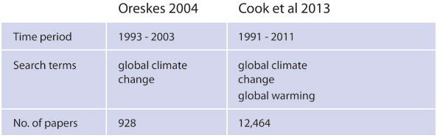

Slide 23
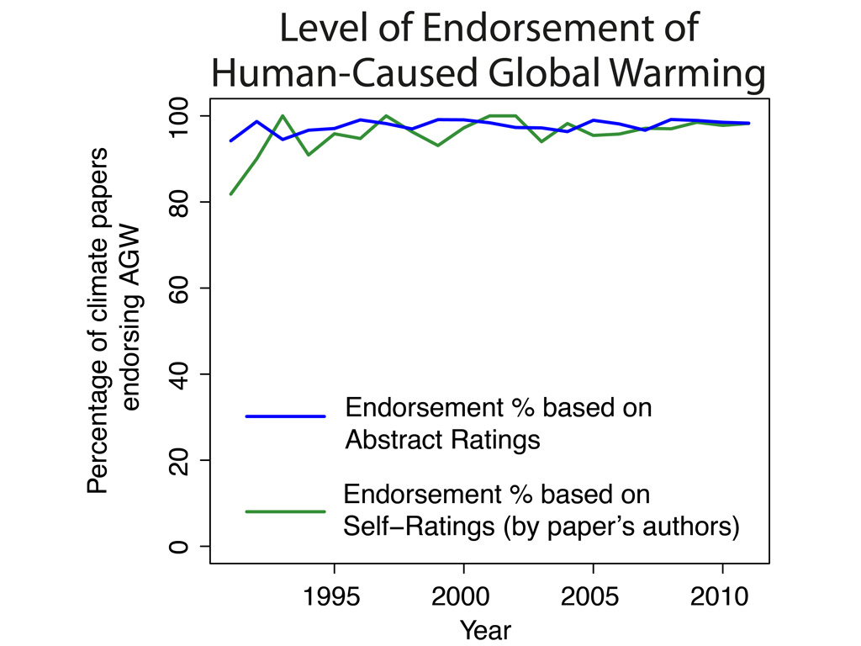

Slide 24
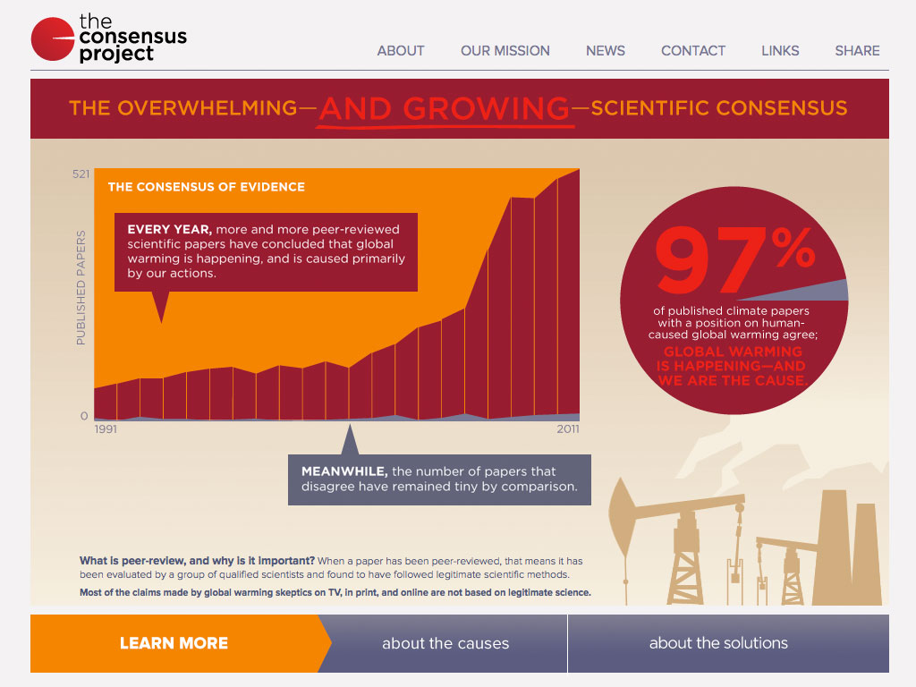

Slide 25
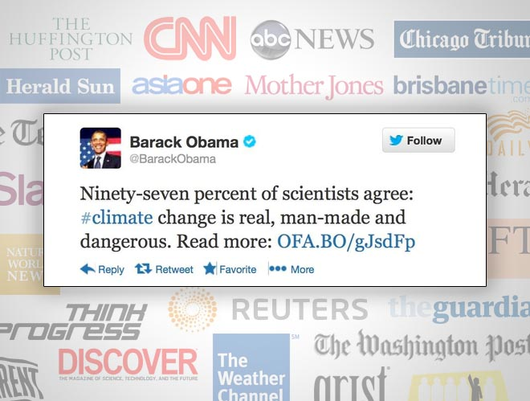

Slide 26


Slide 27
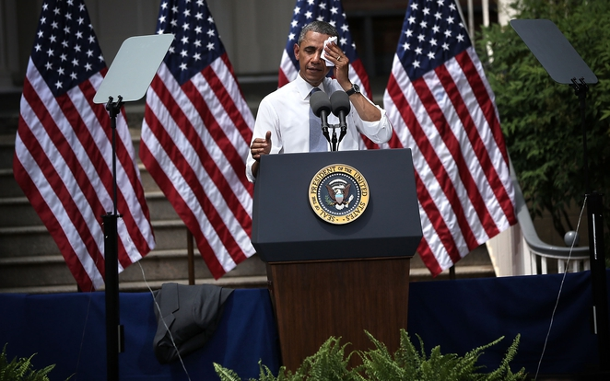

Slide 28
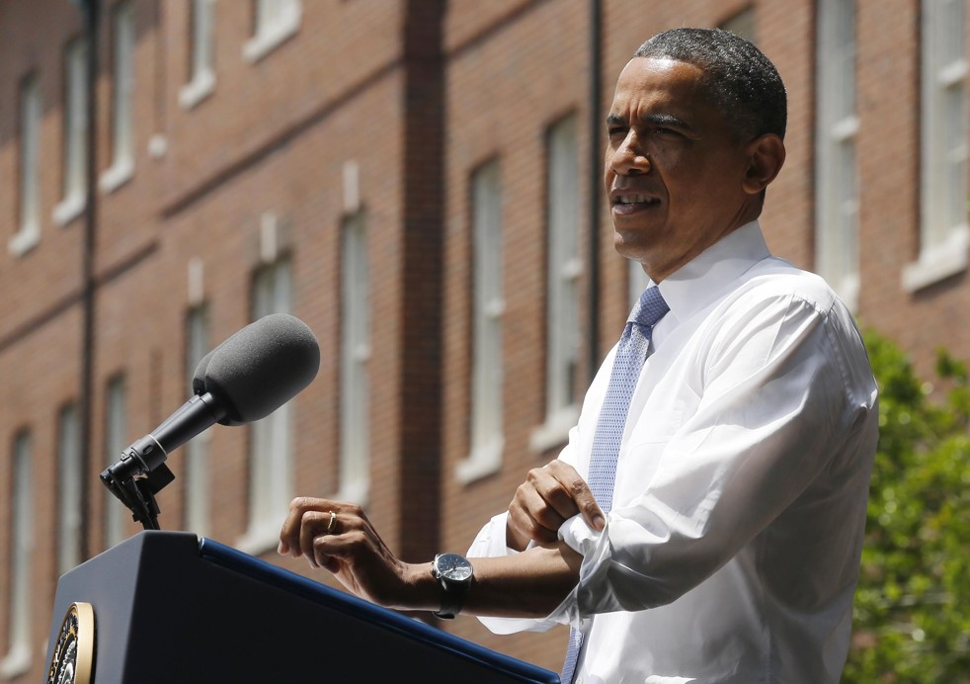
“97% of scientists, including, by the way, some who originally disputed the data, have now put that to rest. They’ve acknowledged the planet is warming and human activity is contributing to it.”
PRESIDENT OBAMA

Slide 29
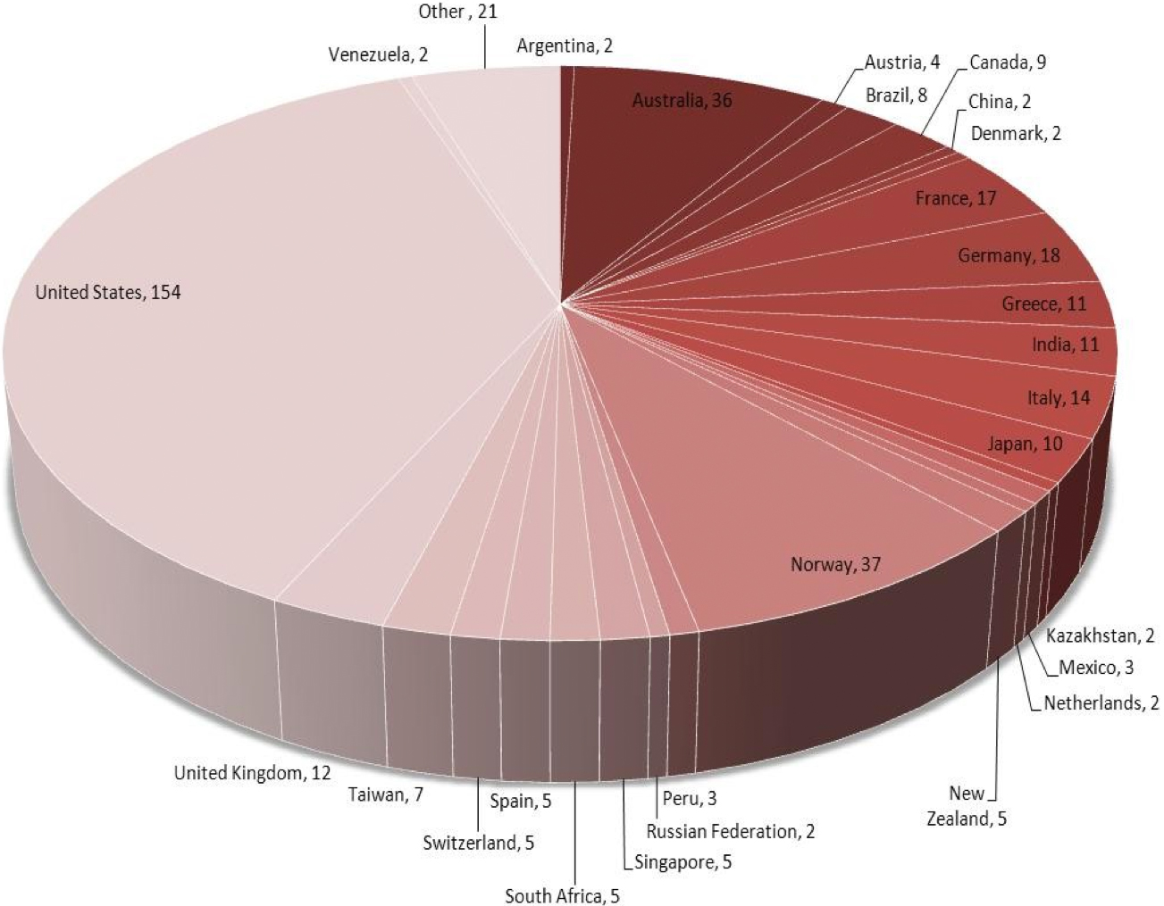
Media Coverage of Cook et al. (2013)

Slide 30
Other measures of Impact
Top 1% of scholarly papers published at the same time (Altmetric: measure of online buzz)
Top 5% of all scholarly papers published
Cited in a broad range of scholarly journals:
Bioscience
Australian Historical Studies
Proceedings of the Royal Society
European Journal of Media Studies

Slide 31
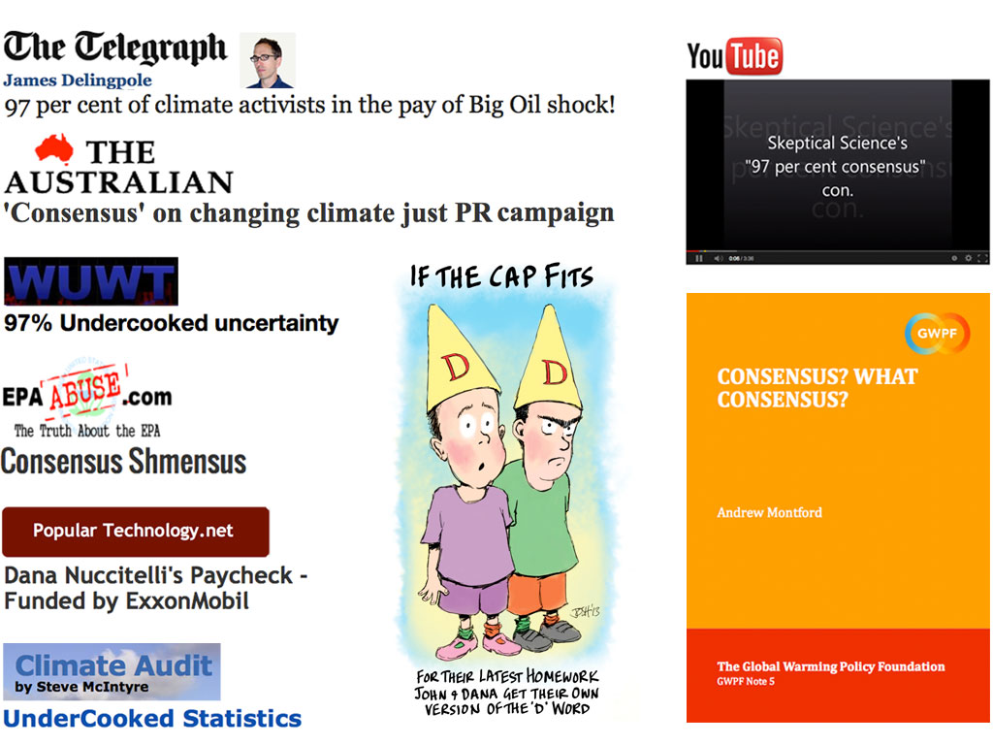
Attacks on Cook et al. (2013)

Slide 32
5 Characteristics of Consensus Denial
All movements that deny a scientific consensus have
5 characteristics in common (Diethelm & McKee 2009).
Fake Debate
Logical Fallacies
Impossible Expectations
Cherry Picking
Conspiracy Theories
FLICC

Slide 33
1. Fake Debate
Manufacture the appearance of ongoing debate among the climate science community

Slide 34

Consensus

Slide 35
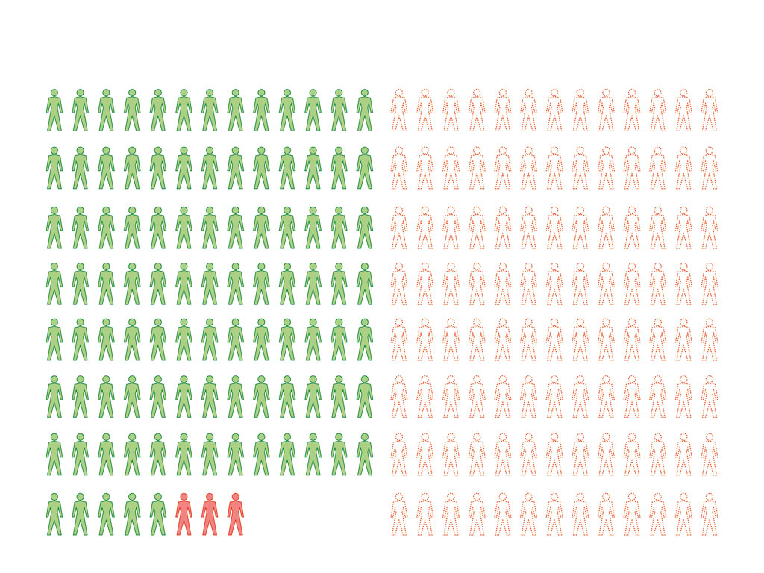
Consensus
Fake Experts
Fake Experts

Slide 36
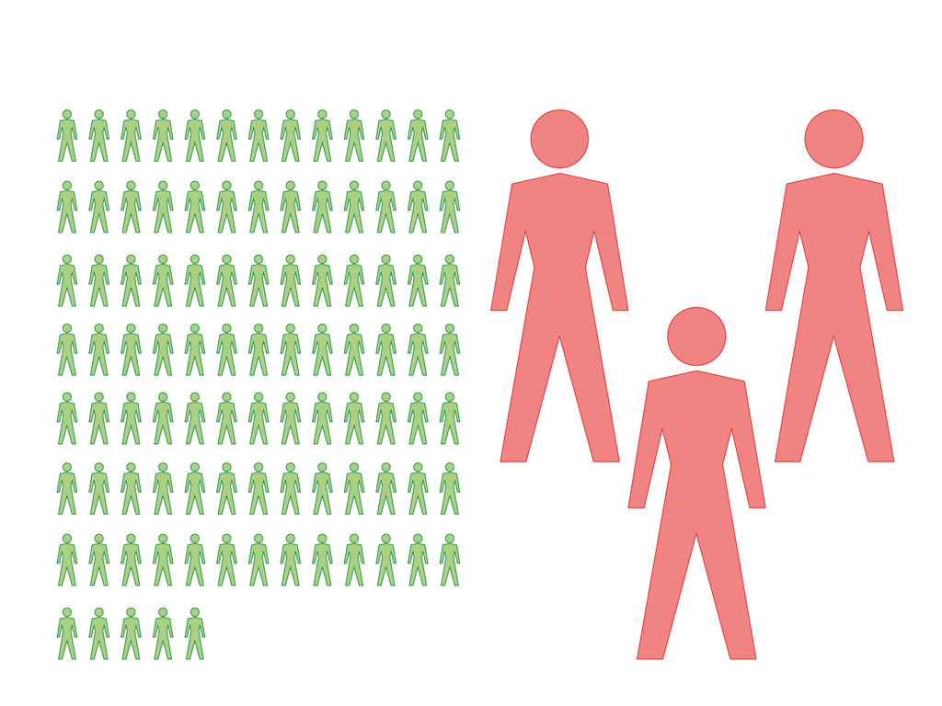
Consensus
Magnify the Minority
Fake Experts

Slide 37
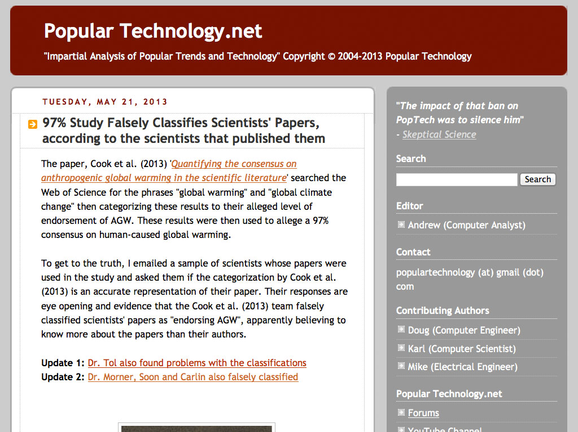

Slide 39
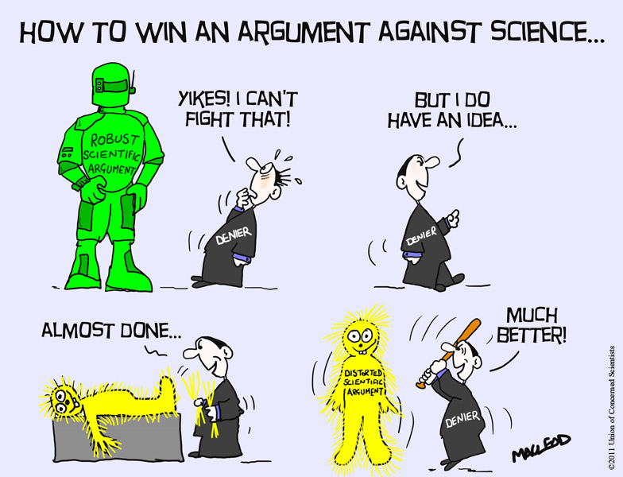
2. Logical
Fallacies
Goalpost shifting
Personal attacks
Straw man

Slide 40
“…the philosophy of science allows no role for headcount statistics. Aristotle’s Sophistical Refutations codified the argument from consensus, later labeled by the medieval schoolmen as the argumentum ad populum or head-count fallacy, as one of the dozen commonest logical fallacies in human discourse.”
LEGATES, SOON, BRIGGS & MONCKTON (2013)

Slide 41
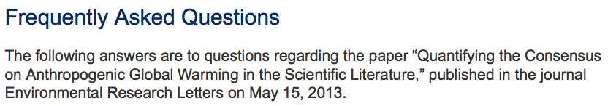
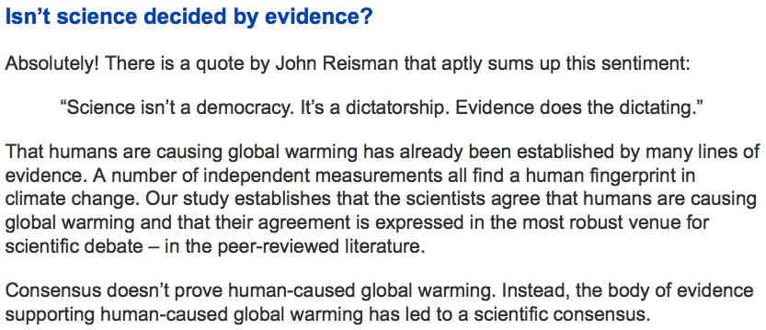

Slide 42
3. Impossible Expectations
Raising the standards of scientific proof to an impossible level
Tactic perfected by tobacco industry

Slide 43
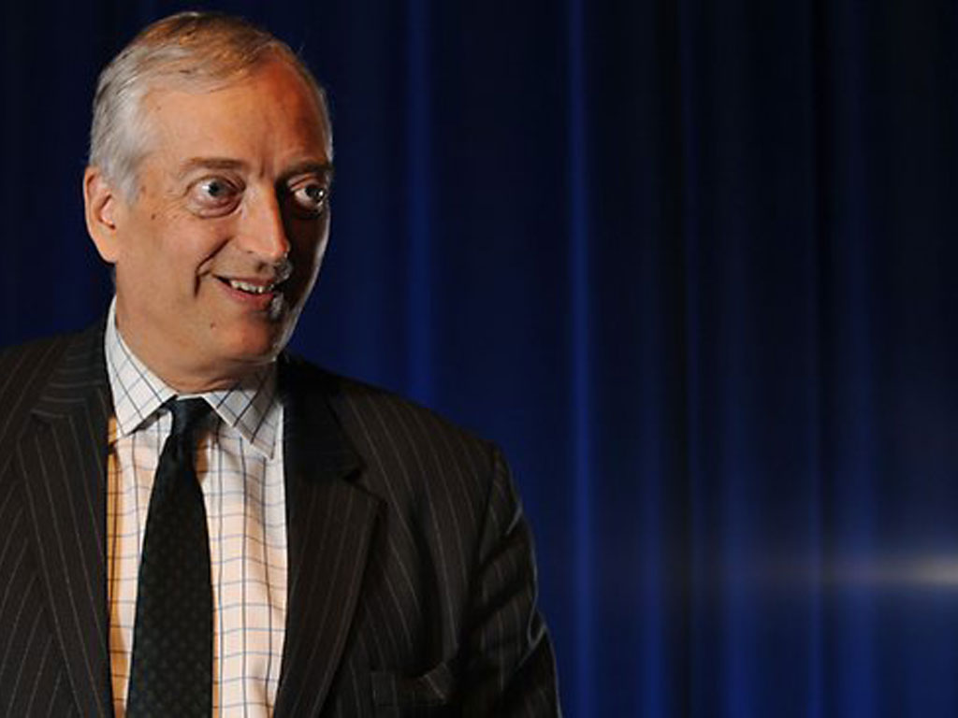
“The latest paper apparently showing 97% endorsement of a consensus that more than half of recent global warming was anthropogenic really shows only 0.3% endorsement of that now-dwindling consensus.”
CHRISTOPHER MONCKTON
Notes:
43

Slide 44
Papers Endorsing the Consensus Without Quantification
“Global warming caused by green house gases emitted into the air is a result of the human activities.”
“… emission reduction efforts alone are unlikely to stabilize greenhouse gas concentrations at levels low enough to prevent dangerous anthropogenic interference with the climate system.”
“Accumulating evidence points to an anthropogenic 'fingerprint' on the global climate change that has occurred in the last century.”

Slide 45
4. Cherry Picking

Slide 47

How to Explain a Consensus?
Notes:
47

Slide 48
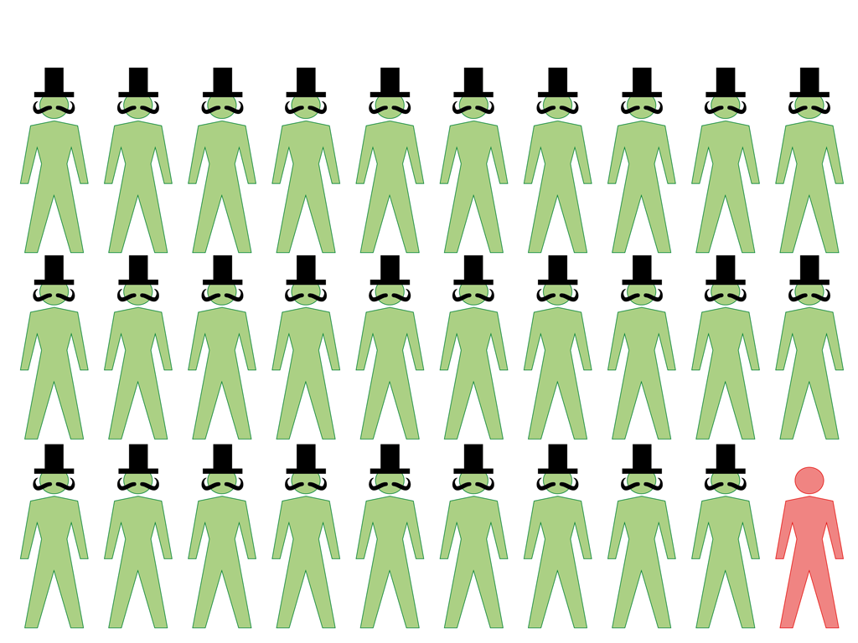
5. Conspiracy Theories
Notes:
48

Slide 49
“A paper came out in a journal which I suspect was created just so that they could publish this paper because no proper peer reviewed journal would have published it.”
CHRISTOPHER MONCKTON
Notes:
49

Slide 50
Environmental Research Letters
Published by the Institute of Physics who publishes over 70 peer-reviewed journals
ERL has published 1029 scholarly articles since created in 2006
Impact factor in 2012 was 3.58, in same bracket as long established journals such as Geophysical Research Letters and Climatic Change
80,000 downloads of scholarly articles per month
Innovations such as video abstracts (resulted in doubling of paper downloads)

Slide 51
Conclusion
Opponents of climate action have campaigned for two decades to manufacture doubt about the scientific consensus
Closing the “Consensus Gap” will remove a roadblock that has prevented public support for policy to mitigate climate change

