Slide 1
The Importance of Consensus Information in Reducing the Biasing Influence of Worldview on Climate Change Attitudes
John Cook
12 October 2013, Psychology for a Safe Climate
Global Change Institute, University of Queensland
University of Western Australia
University of Bristol

Slide 2
Climate communication magic bullet
There is no such thing as a climate communication magic bullet: we need a range of messages for diverse audiences
Some bullets are more potent than others
Some targets are easier to hit than others

Slide 3
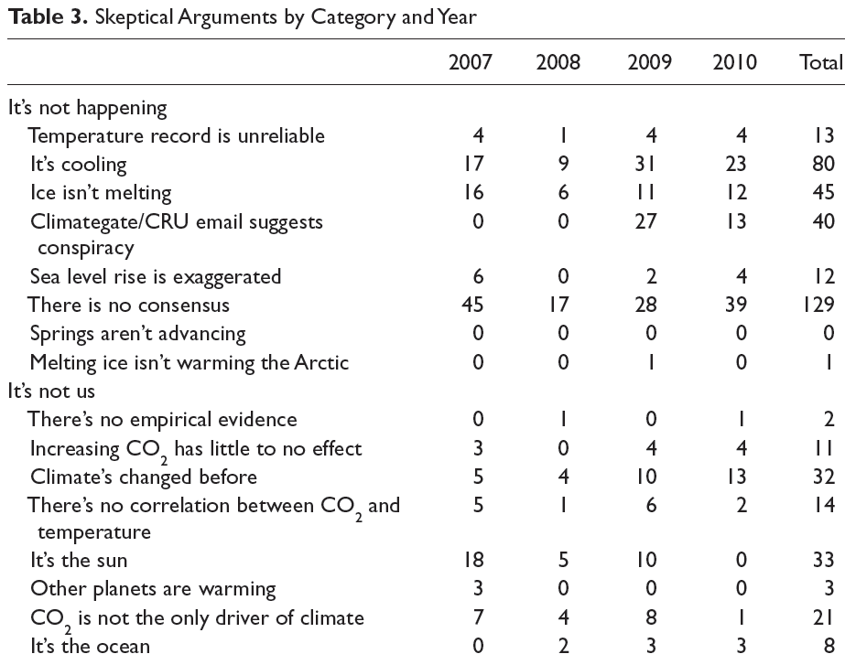

Slide 4
“Voters believe that there is no consensus about global warming in the scientific community. Should the public come to believe that the scientific issues are settled, their views about global warming will change accordingly. Therefore, you need to continue to make the lack of scientific certainty a primary issue in the debate.”
FRANK LUNTZ

Slide 5
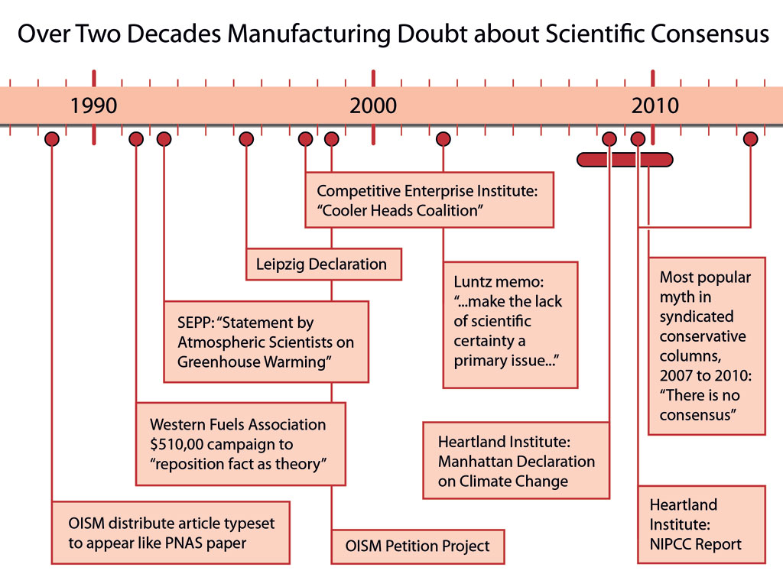

Slide 6
The importance of consensus
Ding et al 2011 found that people who believe scientists disagree on global warming are less likely to support climate policy
McCright et al 2013: “Climate change communicators should therefore identify opportunities and employ techniques to effectively counter the denial machine’s campaign of challenging the scientific consensus. Overcoming its success in generating belief that scientists do not agree about anthropogenic global warming seems to be crucial for increasing public support for emissions reduction policies.”

Slide 7
Some bullets are more potent than others.

Slide 8
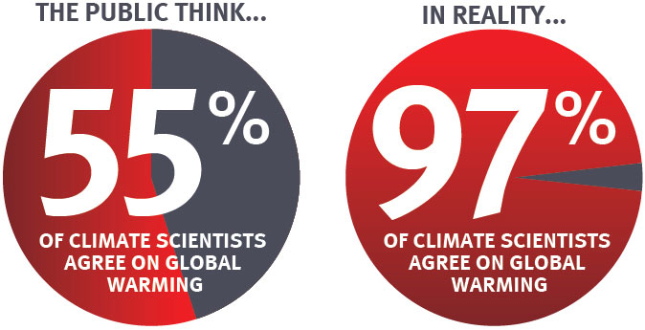
The “Consensus Gap”

Slide 9
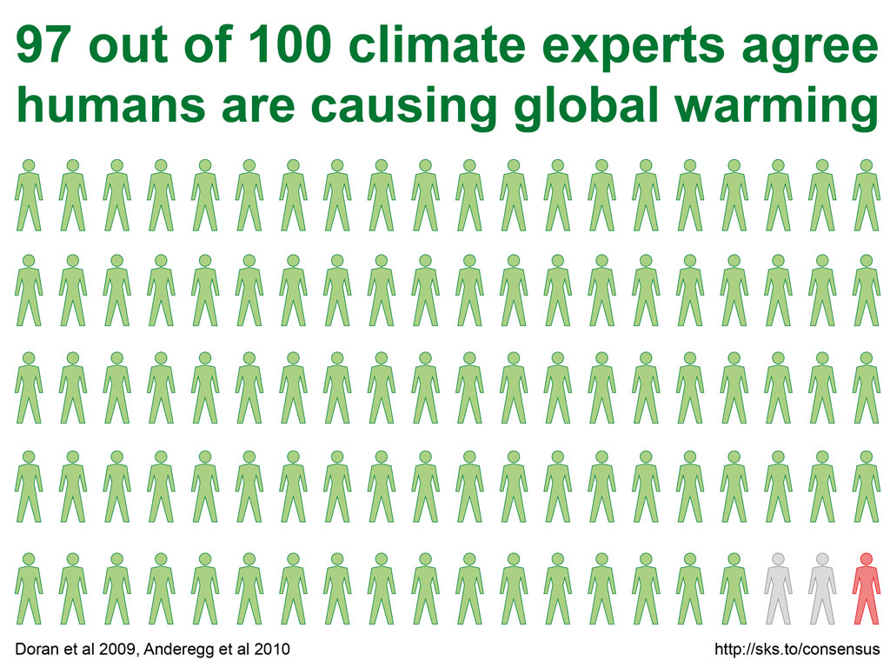

Slide 10
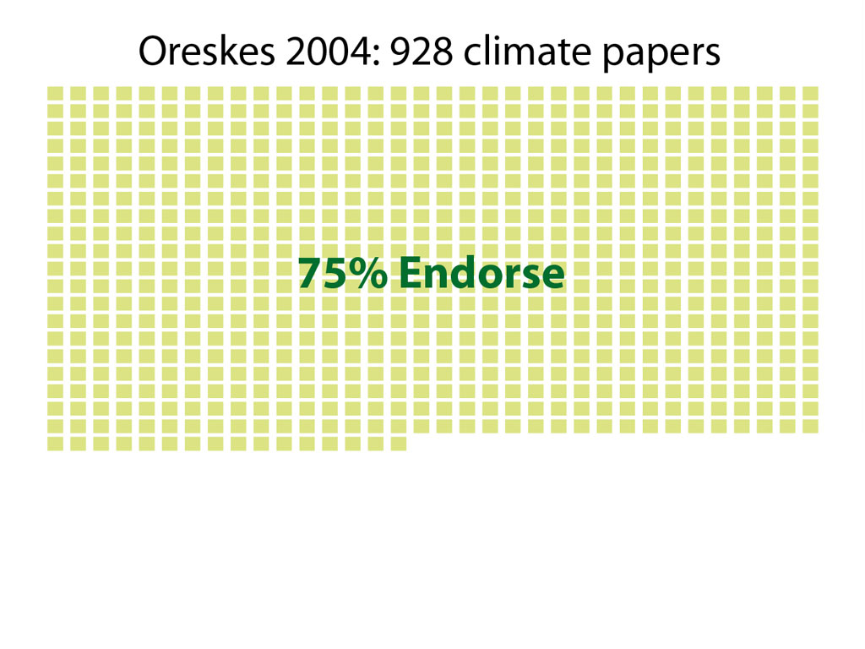

Slide 11
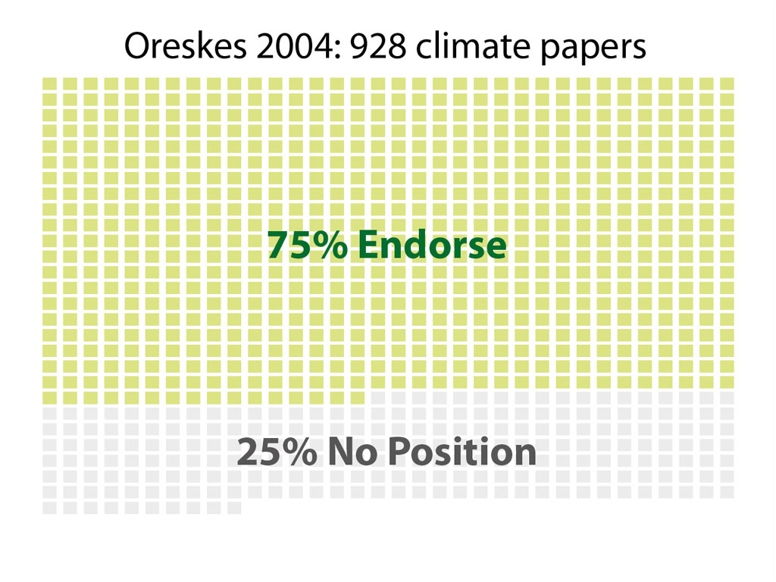

Slide 12
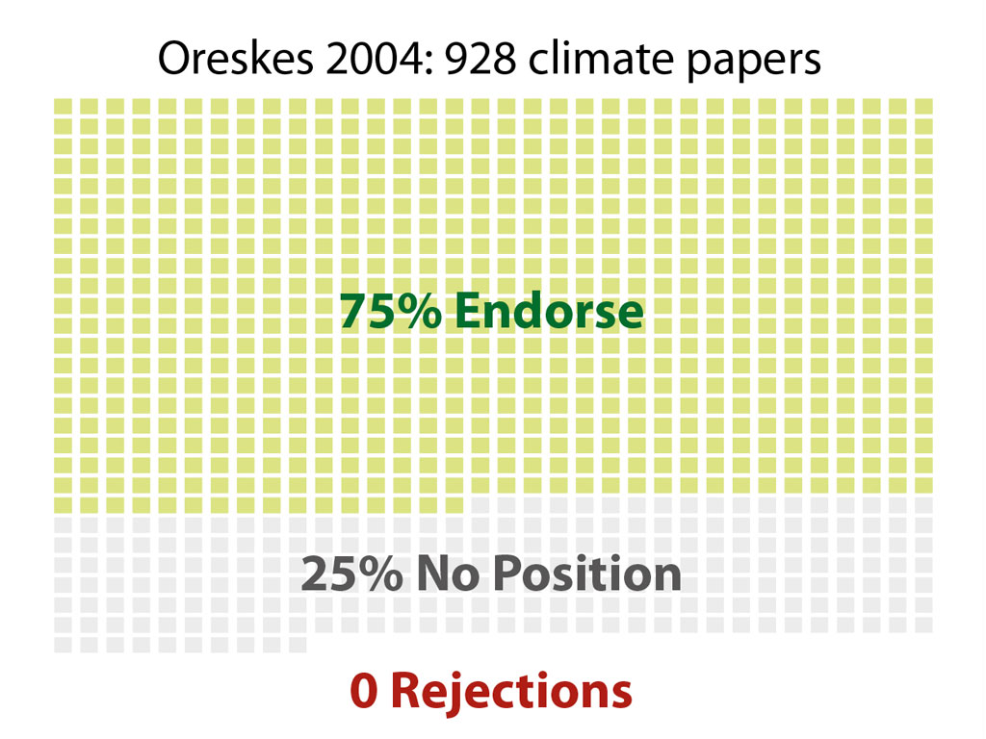

Slide 14
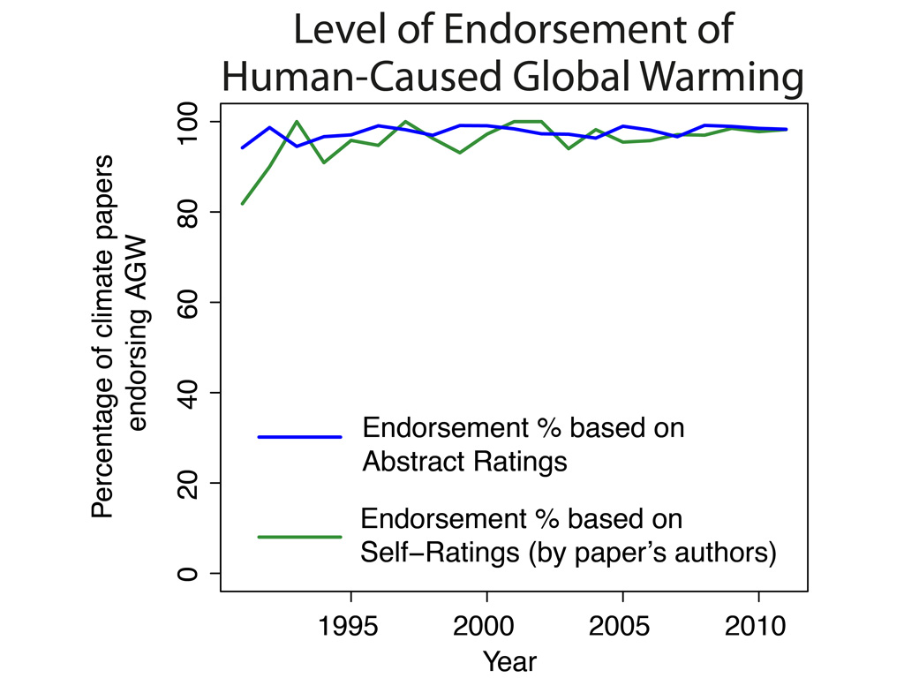

Slide 15
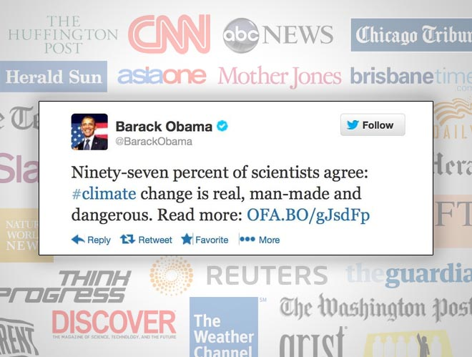

Slide 16
Attacks on Cook et al. (2013)

Slide 17
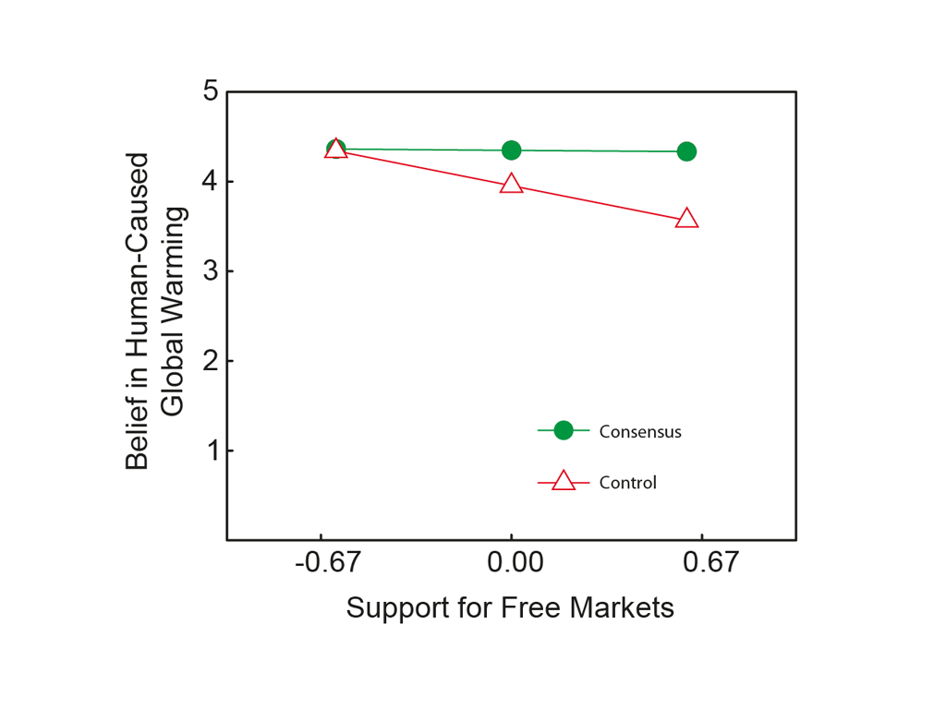
Lewandowsky et al 2013
Significant, positive interaction between consensus and worldview.

Slide 18
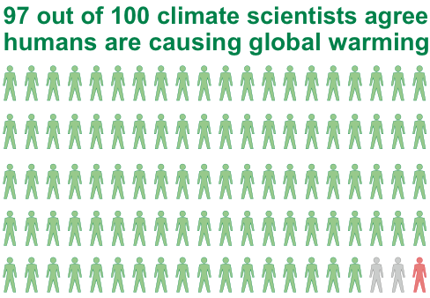
Study on effect of consensus information

Slide 19
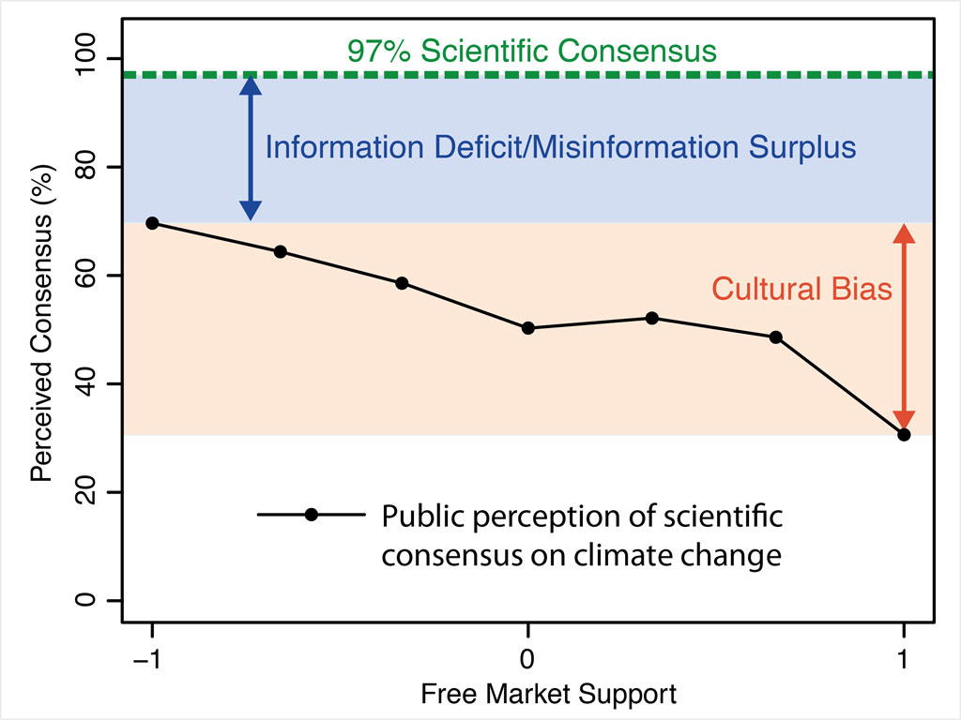

Slide 20
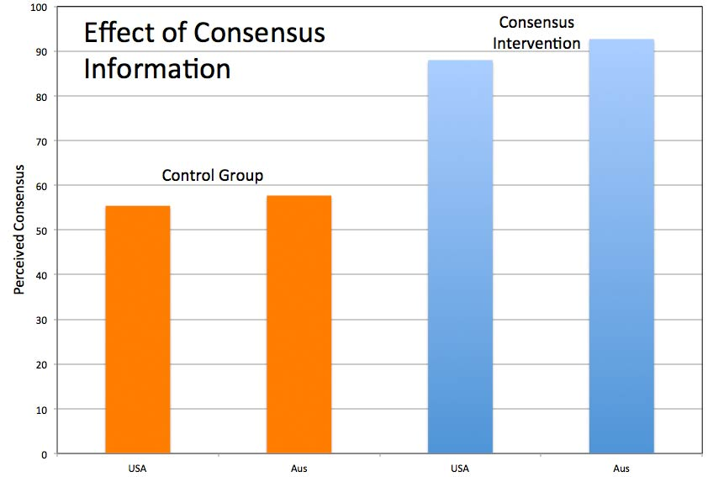

Slide 21
Some targets are easier to hit than others.

Slide 22
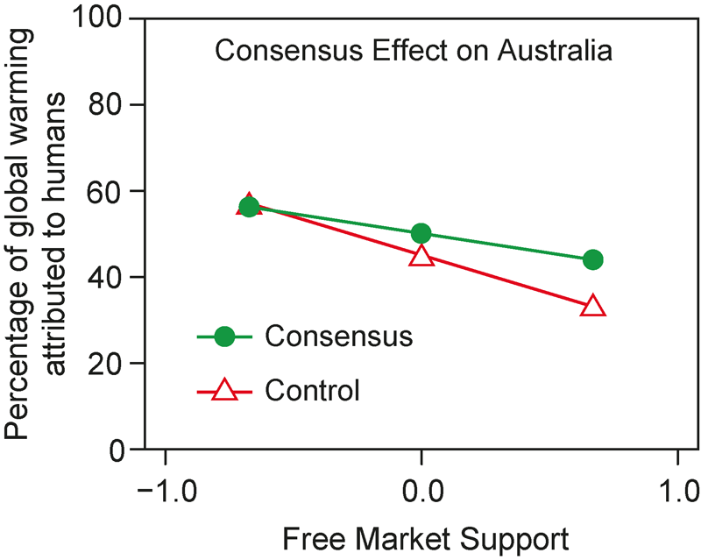
Consensus info on Australian sample
Representative Australian sample (N=400)
Positive (weaker) interaction between consensus and worldview

Slide 23
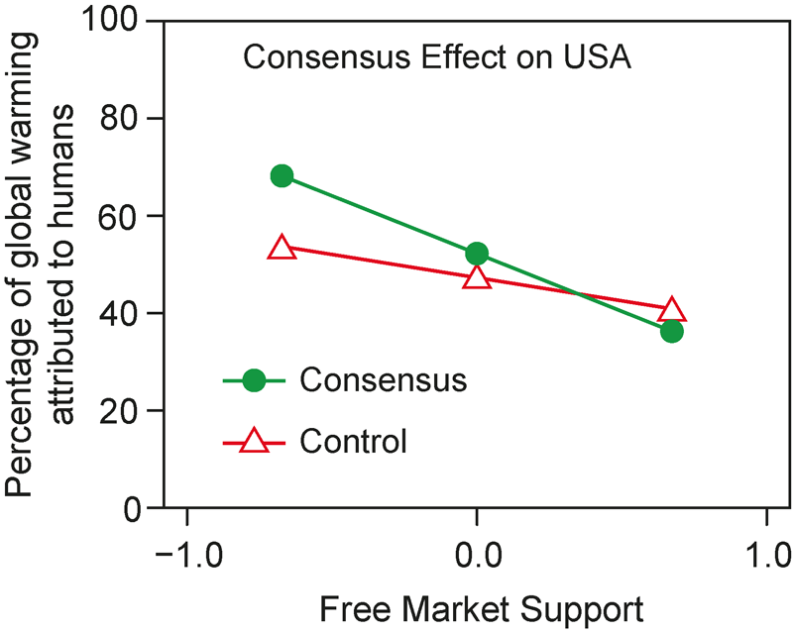
Testing consensus info on USA sample
Representative US sample (N=325)
Significant, negative interaction between consensus and worldview.

Slide 24
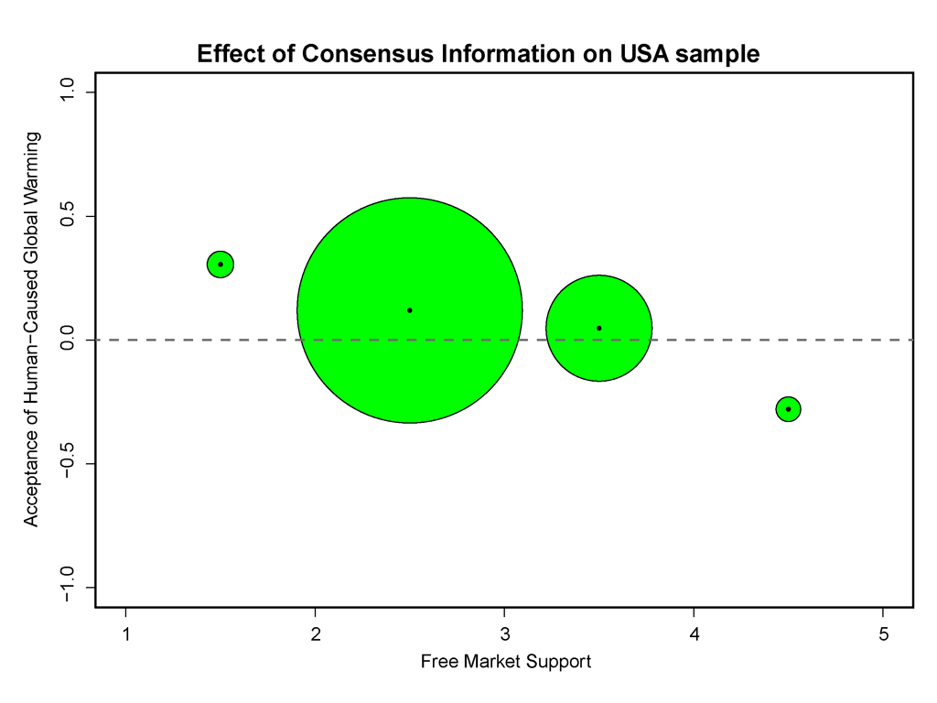

Slide 25
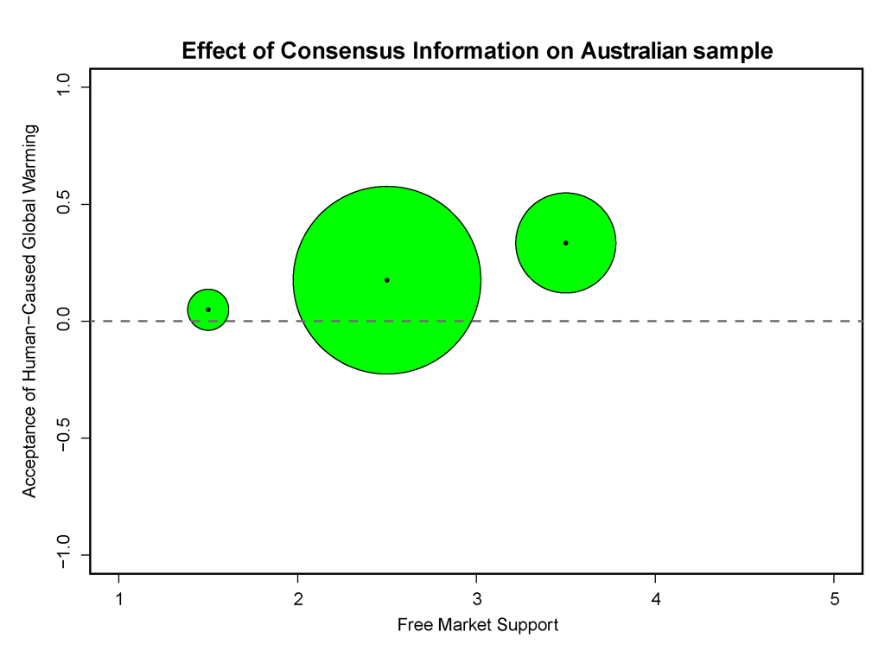

Slide 26
Conclusion
There is a significant gap between public perception of consensus and the 97% reality
We need to close the consensus gap to remove one roadblock to climate action
Presenting consensus information has a significant positive effect on acceptance of human-caused global warming

Slide 27
John Cook
Global Change Institute, University of Queensland
University of Western Australia
Web: www.skepticalscience.com

